Slide 1
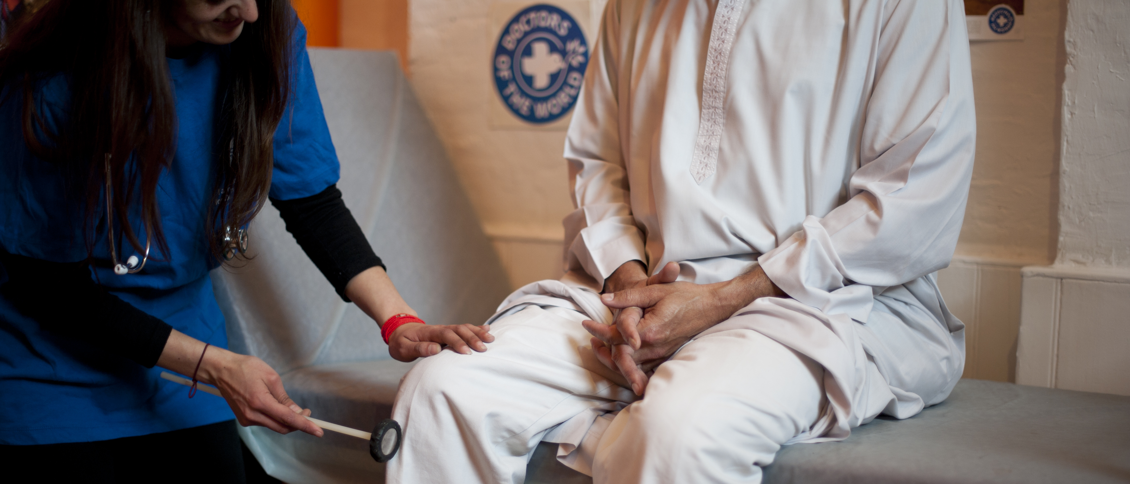

SAFE SURGERIES
Quality Improvement Project (QIP)
Introduction
Doctors of the World UK, part of the Médecins du Monde network

Slide 2
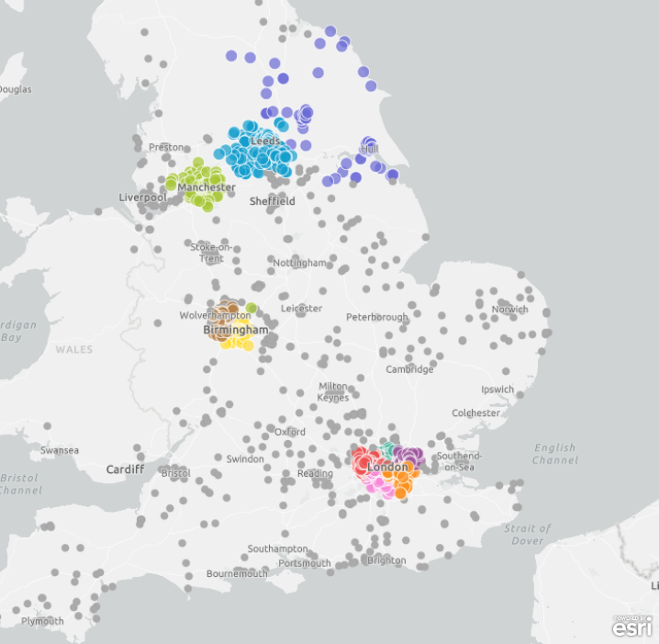
Introduction to Safe Surgeries
Building an expert community against health exclusion
A network of GP practices demonstrating adherence to NHS England guidance and making commitments to tackle barriers to healthcare faced by underserved communities
Launched by DOTW in 2018, in partnership with primary care - recognising pressures and increasing workloads facing GP practices
Free training, resources and support
2,500+ Safe Surgeries across the UK…

Slide 3
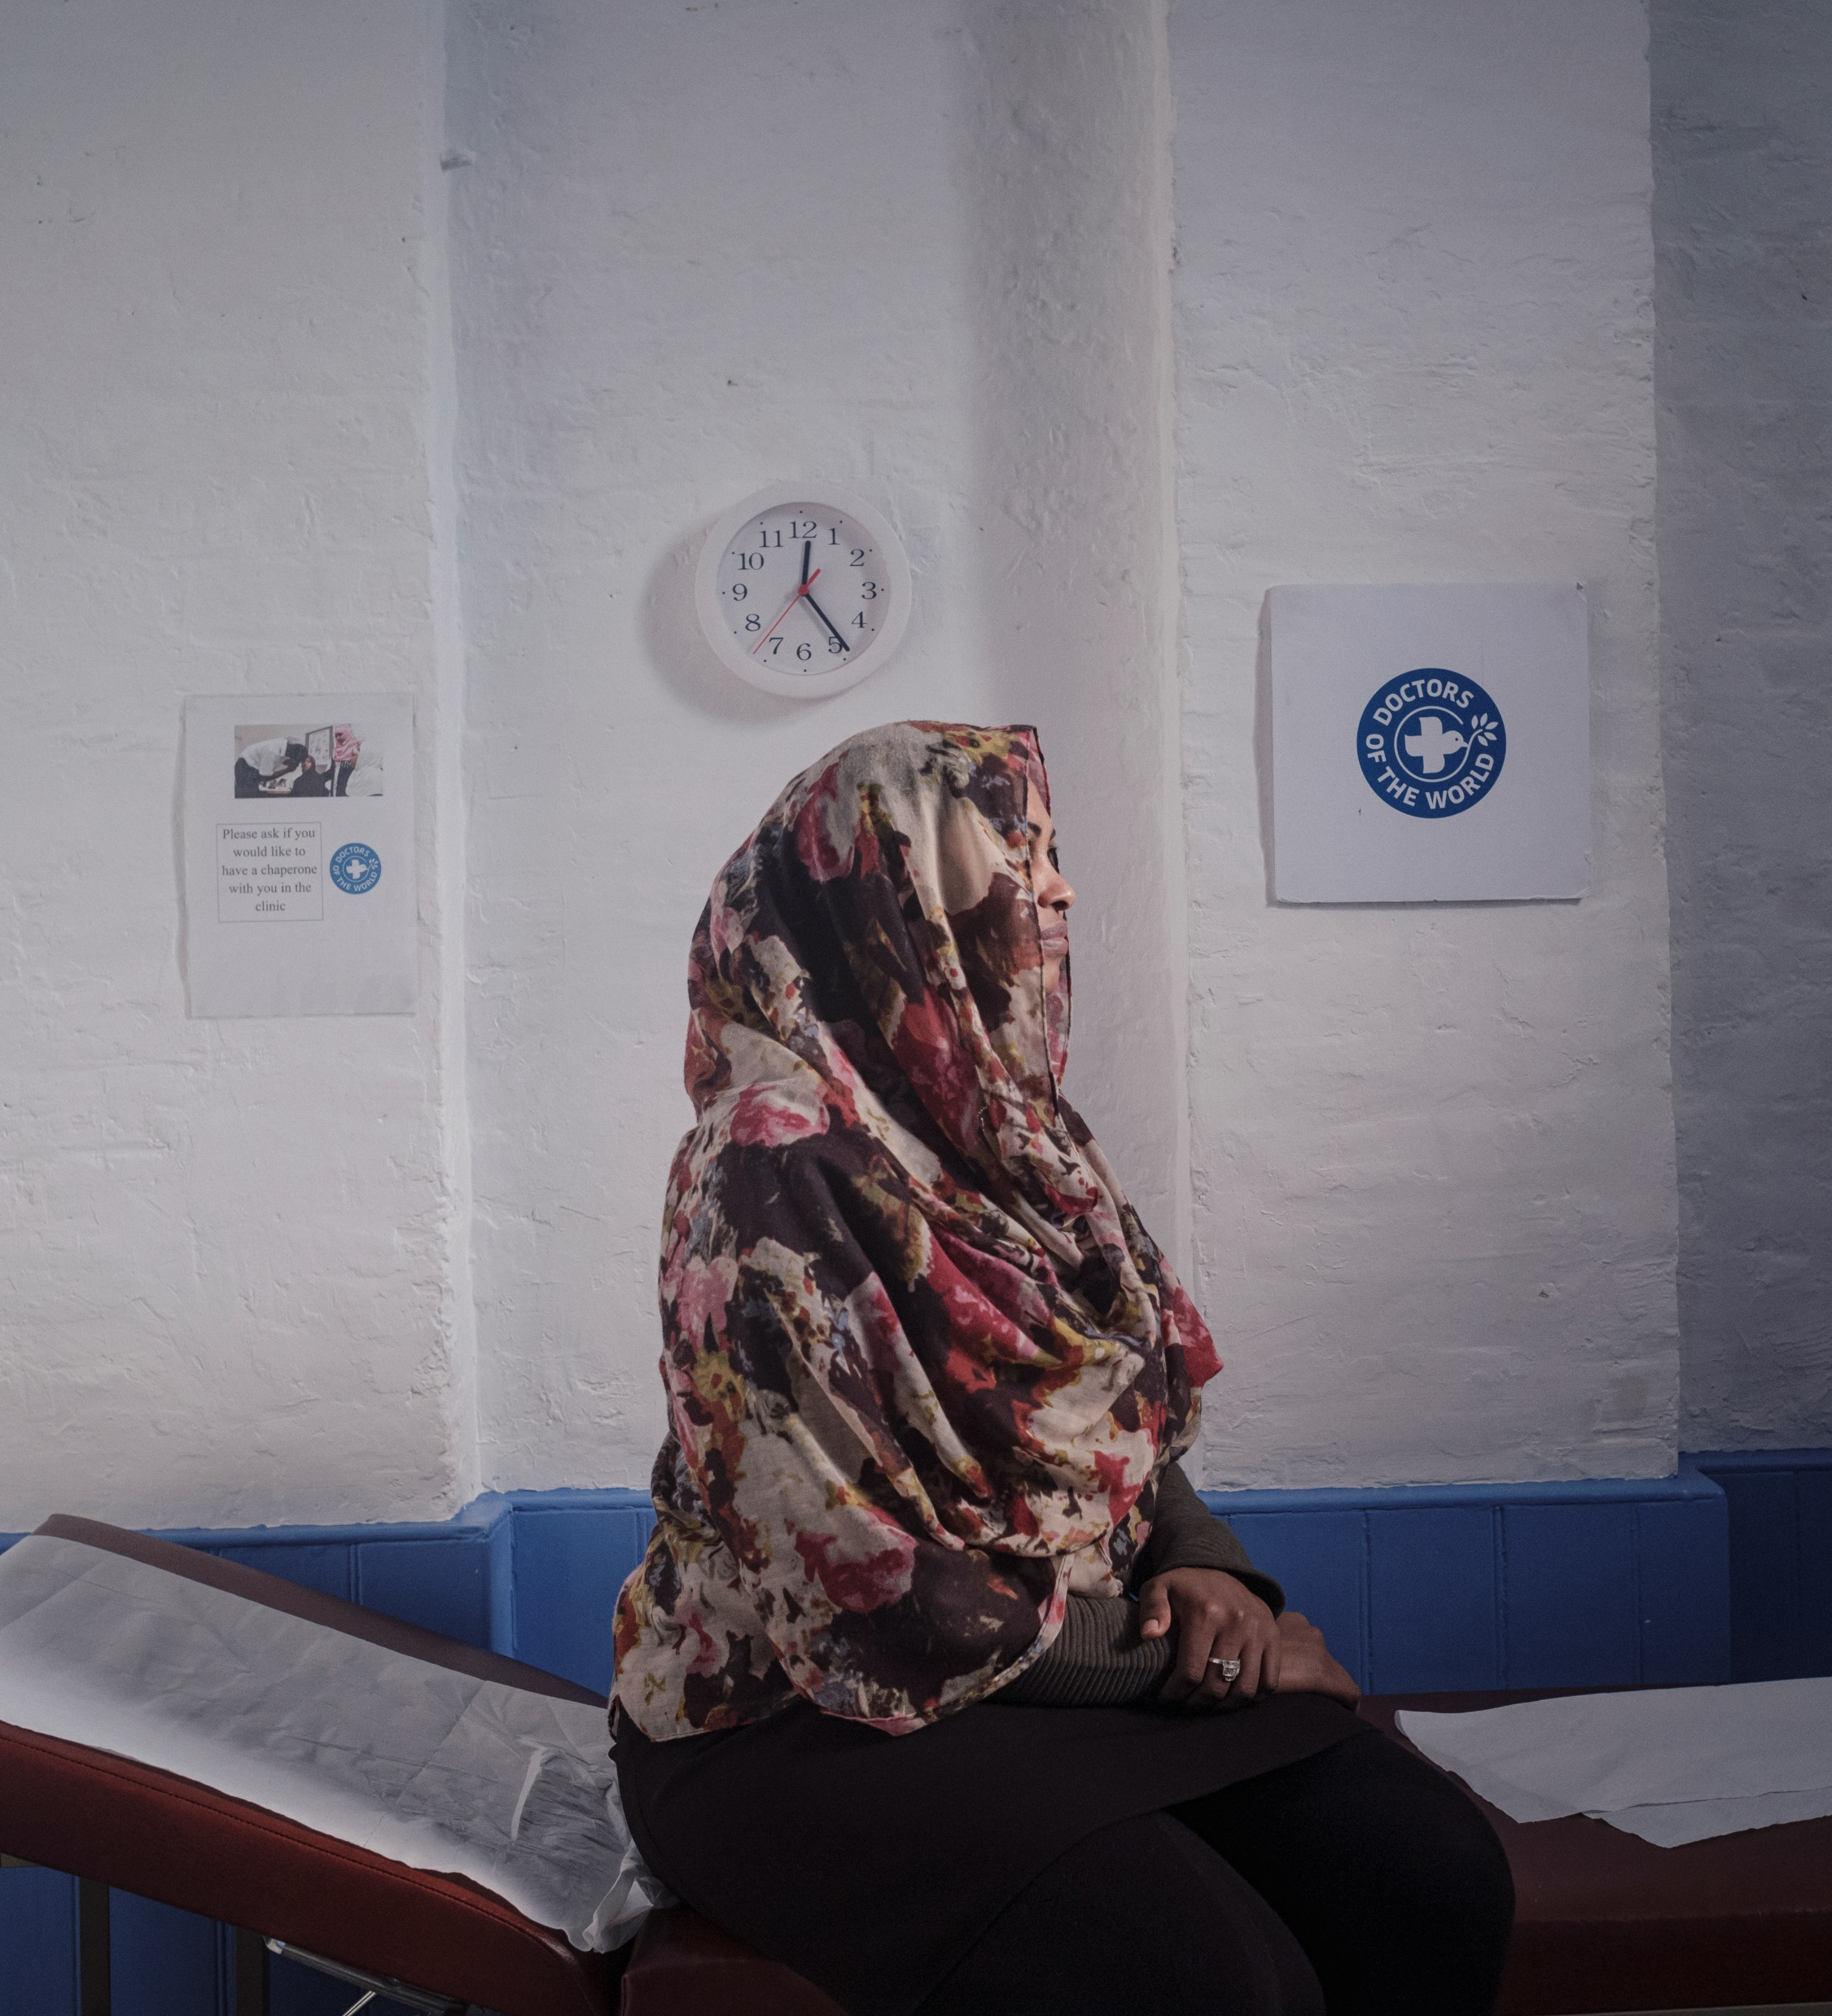
Why is this important?
Evidence from Doctors of the World highlights the issues in primary healthcare access and registration refusal for many vulnerable migrants and other inclusion health groups, including pregnant women, children, people seeking asylum and refugees, survivors of trafficking
Practice administrative procedures and lack of awareness of NHS England policy means that many GP practices have barriers to access

Slide 4
Why become a Safe Surgery?
Comply with NHS policy
Be part of a supportive national network
CQC approved
Improve efficiency and communication in the registration process
Improve patient experience
Meet the needs of your community
Support staff learning and skills building
Share good practice
Ensure lack of documents, immigration status and language do not prevent registration
CQC Equity in Access Framework
We make sure that everyone can access the care, support and treatment they need when they need it. People can access care, treatment and support when they need to and in a way that works for them, which promotes equality, removes barriers or delays and protects their rights.'

Slide 5
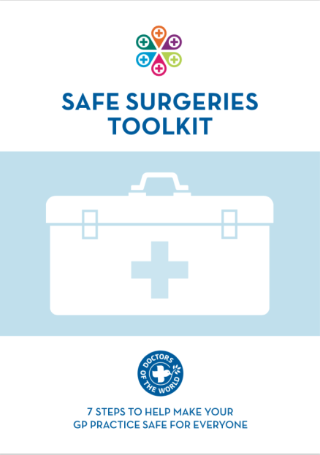
What is the Safe Surgeires QIP?
ST3 led Quality Improvement Project
Designed to disseminate the Safe Surgeries Initiative across GP practices
Aims to improve access to healthcare for people in vulnerable circumstances.
Trainees will assess current practices, implement the Safe Surgeries training, reassess the success of the training and present their findings

Slide 6
QIP process
Baseline assessment:
all GP staff members complete the Knowledge & Attitudes survey
1 hour training session for all staff (admin and clinical) delivered by ST3
Implement Safe Surgeries registration policies
Follow-up evaluation:
3 months re-assessment
Data collation, analysis and presentation. Share findings with DOTW to receive Safe Surgeries champion certificate
Introduce the QIP to your practice, inform DOTW and join the Safe Surgeries network
Baseline assessment:
ST3 observe/interview admin staff to assess current practices over 1-2 weeks (Practice Policy Review)

Slide 7
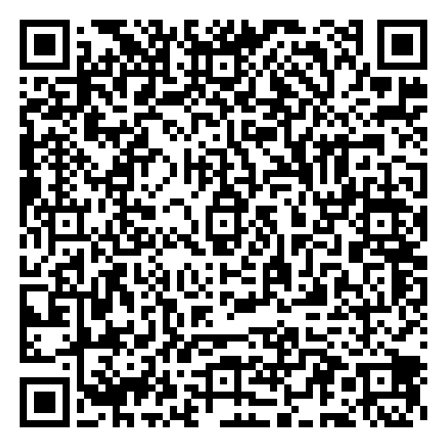

Join the community
Become a
Safe Surgery
and ensure that nobody in your community is excluded
Find out more: https://www.doctorsoftheworld.org.uk/safesurgeries/
Contact us safesurgeries@doctorsoftheworld.org.uk

