Slide 1
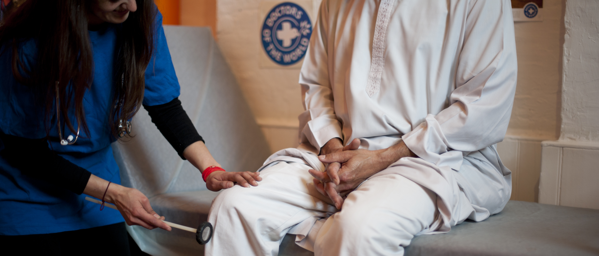

RIGHT TO HEALTHCARE
Improving access to healthcare for people in vulnerable circumstances
Doctors of the World UK, part of the Médecins du Monde network

Slide 2
Objectives
Discuss the importance of access to healthcare
Be aware of the barriers to healthcare access impacting underserved communities
Understand entitlements to NHS primary and secondary care in England
Know what good practice is to promote access to healthcare and support patients in vulnerable circumstances

Slide 3

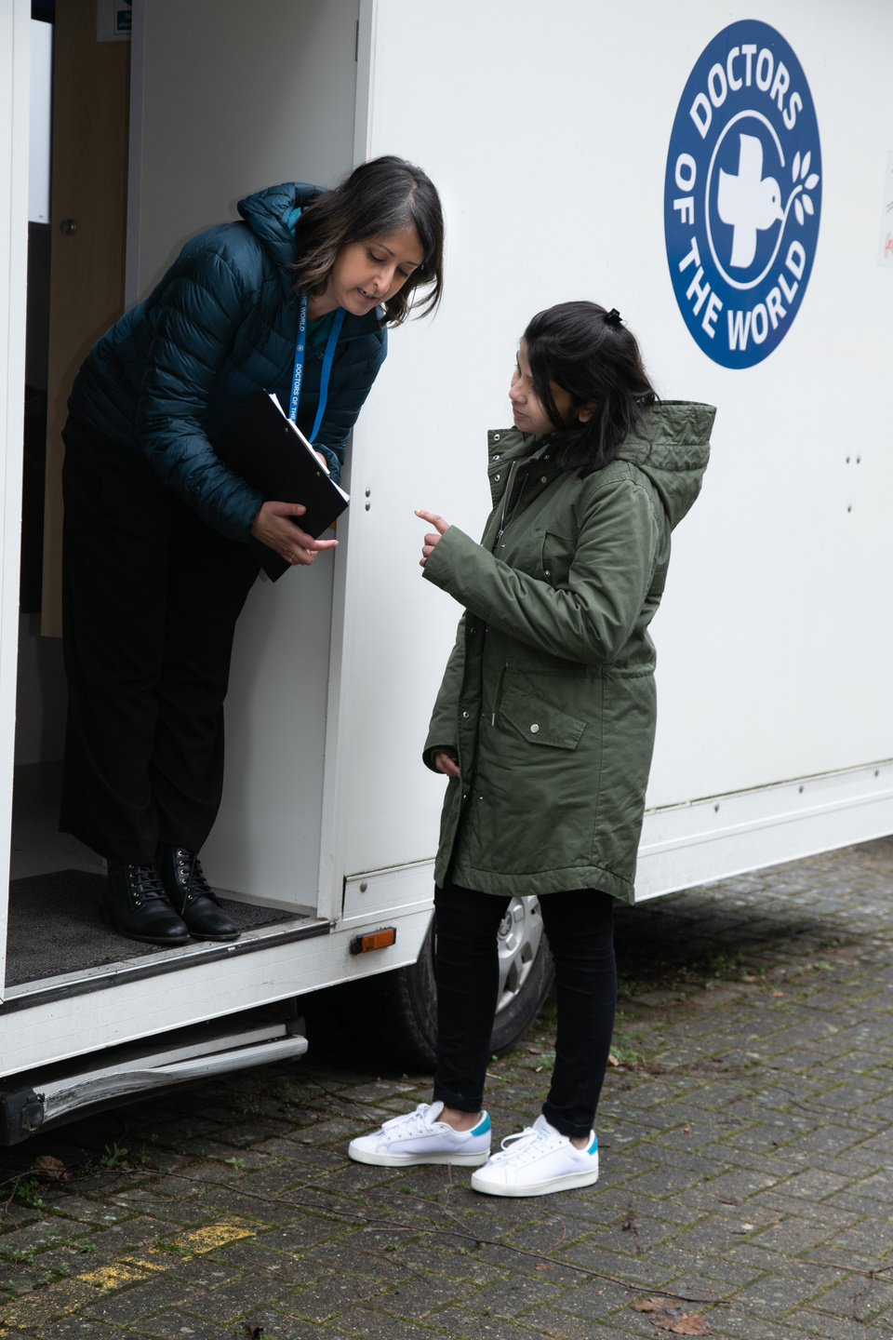
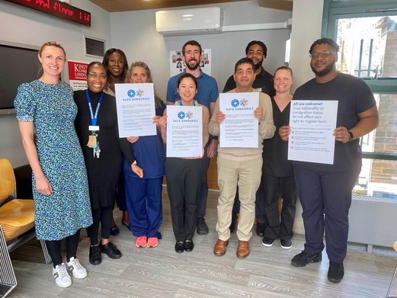
Our work in the UK
SUPPORTING GP PRACTICES
Safe Surgeries initiative: network of GP practices across the UK working to improve registration processes and reduce health inequalities
ADVOCATING FOR CHANGE
DIRECT SUPPORT TO INDIVIDUALS
Supported by our volunteer team of 35 Experts by Experience we aim to make systemic changes to how those currently excluded from healthcare can access health services
Our team of volunteer doctors, nurses and caseworkers provide medical advice and support to people in the UK who cannot access healthcare through our primary care clinic and advice line

Slide 4
Importance of GP registration
Safe discharge
Long-term follow up and continuity of care
Efficient use of services
Patients who face barriers to GP registration may attend A+E if issues become acute/not integrated into NHS services
Public health
Prevention and early detection of disease
Vaccination + screening programmes
Health equity
Cost effective
Promotes a fairer society
Financial + human cost of delayed access to care and preventative interventions
Core principle of the NHS is that it provides a ‘comprehensive service, available to all’
Human rights - UK is bound to give equal access to the right to health for all persons

Slide 5

Inclusion health
Inclusion health is a ‘catch-all’ term used to describe people who are socially excluded, typically experience multiple overlapping risk factors for poor health, experience stigma and discrimination, and are not consistently accounted for in electronic records
Inclusion Health groups are not a homogenous group and may be facing a wide variety of experiences
People from Inclusion Health groups are more likely to experience health inequalities and barriers to public services
Underserved groups face significant barriers in accessing healthcare
People with insecure immigration status
People experiencing homelessness
People from Gypsy, Roma and Traveller communities
People who sell sex
Survivors of modern day slavery
People who have experienced domestic violence
People recently released from prison
People with learning disabilities

Slide 6
Immigration status
Asylum seeker
A person who has left their country of origin and applied for asylum in another country but whose application has not yet been concluded.
Refused asylum seeker
A person whose asylum application has been unsuccessful
Refugee
Undocumented migrant
Someone who enters or stays in the UK without the documents required under immigration regulations.
Someone whose asylum application has been successful. The Government recognises they are unable to return to their country of origin owing to a well-founded fear of being persecuted

Slide 7
Immigration status
‘Undocumented’ migrants find themselves without the right documents for a variety of reasons, often beyond their control.
Survivors of trafficking
People who came to UK to work without a visa
People who came to the UK as children with undocumented parents
People whose visa has expired (student/ working)
Refused asylum seekers
People who don’t claim asylum due to lack of legal advice
People on spousal visas whose relationship breaks down
Domestic workers on expired visas which their employer doesn’t renew

Slide 8

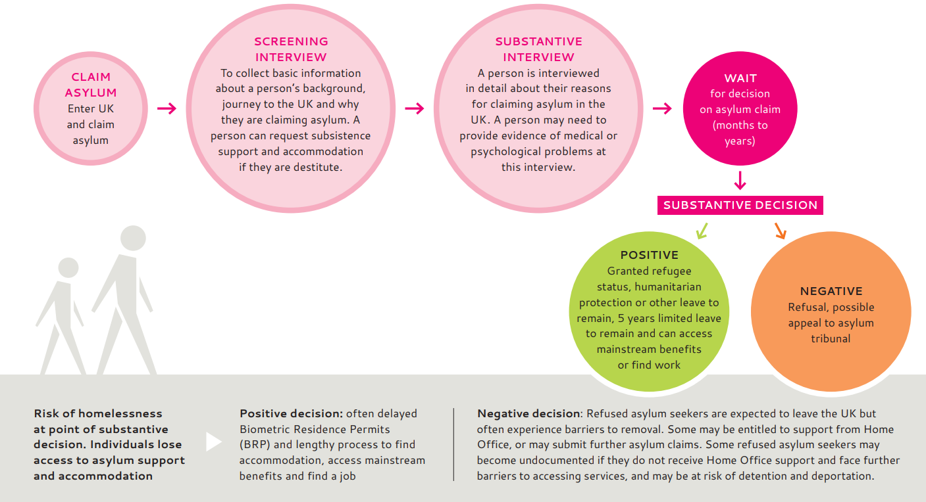
Asylum process
https://www.doctorsoftheworld.org.uk/wp-content/uploads/2025/06/clinician-toolkit-final.pdf

Slide 9
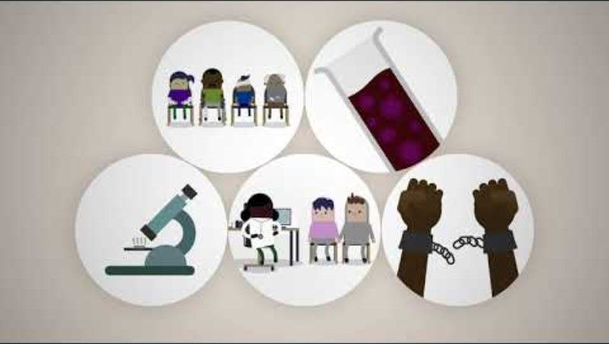

Assessing migrant patients
https://www.youtube.com/watch?v=LVcCNGrxau8

Slide 10
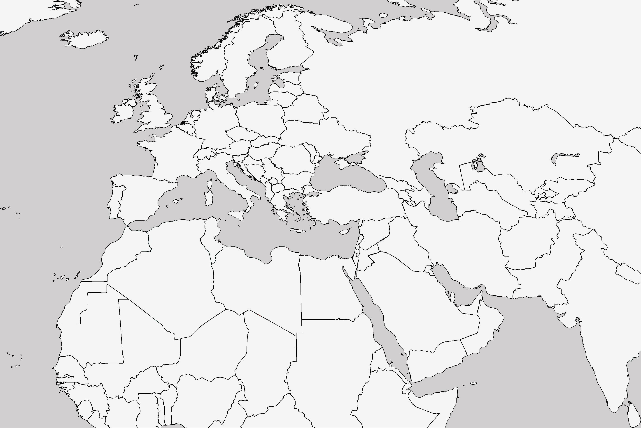
Barriers to accessing healthcare
Street homeless in London, after 2 months taken to a church by a lady she met on the street.
Smuggled to “the Jungle” in Calais and then to London
Imprisoned in Libya; became a street homeless and a victim of sexual assault in Italy.
Miriam (28) fled Eritrea after escaping conscription into national military service.
Notes:
Miriam is a 28 year old lady who fled Eritrea after escaping conscription into national military service. She had been abused, raped and denied medical treatment. She travelled through Sudan, to Libya and then on to Italy.
She was imprisoned in Libya, street homeless in Italy and raped by a group of young men. She was smuggled to ‘the Jungle’ in Calais; by this point her mental health was deteriorating: ‘At that moment I was having a lot of stress…maybe I was screaming, things like that’
She was smuggled into the UK. She was street homeless in London and then after 2 months was taken to a church by a lady she met on the street. “I started to beg her, my feet were swollen and I had been walking up and down for 2 days. I hadn’t showered and I hadn’t eaten well. She could see that I was pregnant”. She was allowed to sleep in the church. Members of the congregation bring her food, and sometimes they let her stay with them.

Slide 11
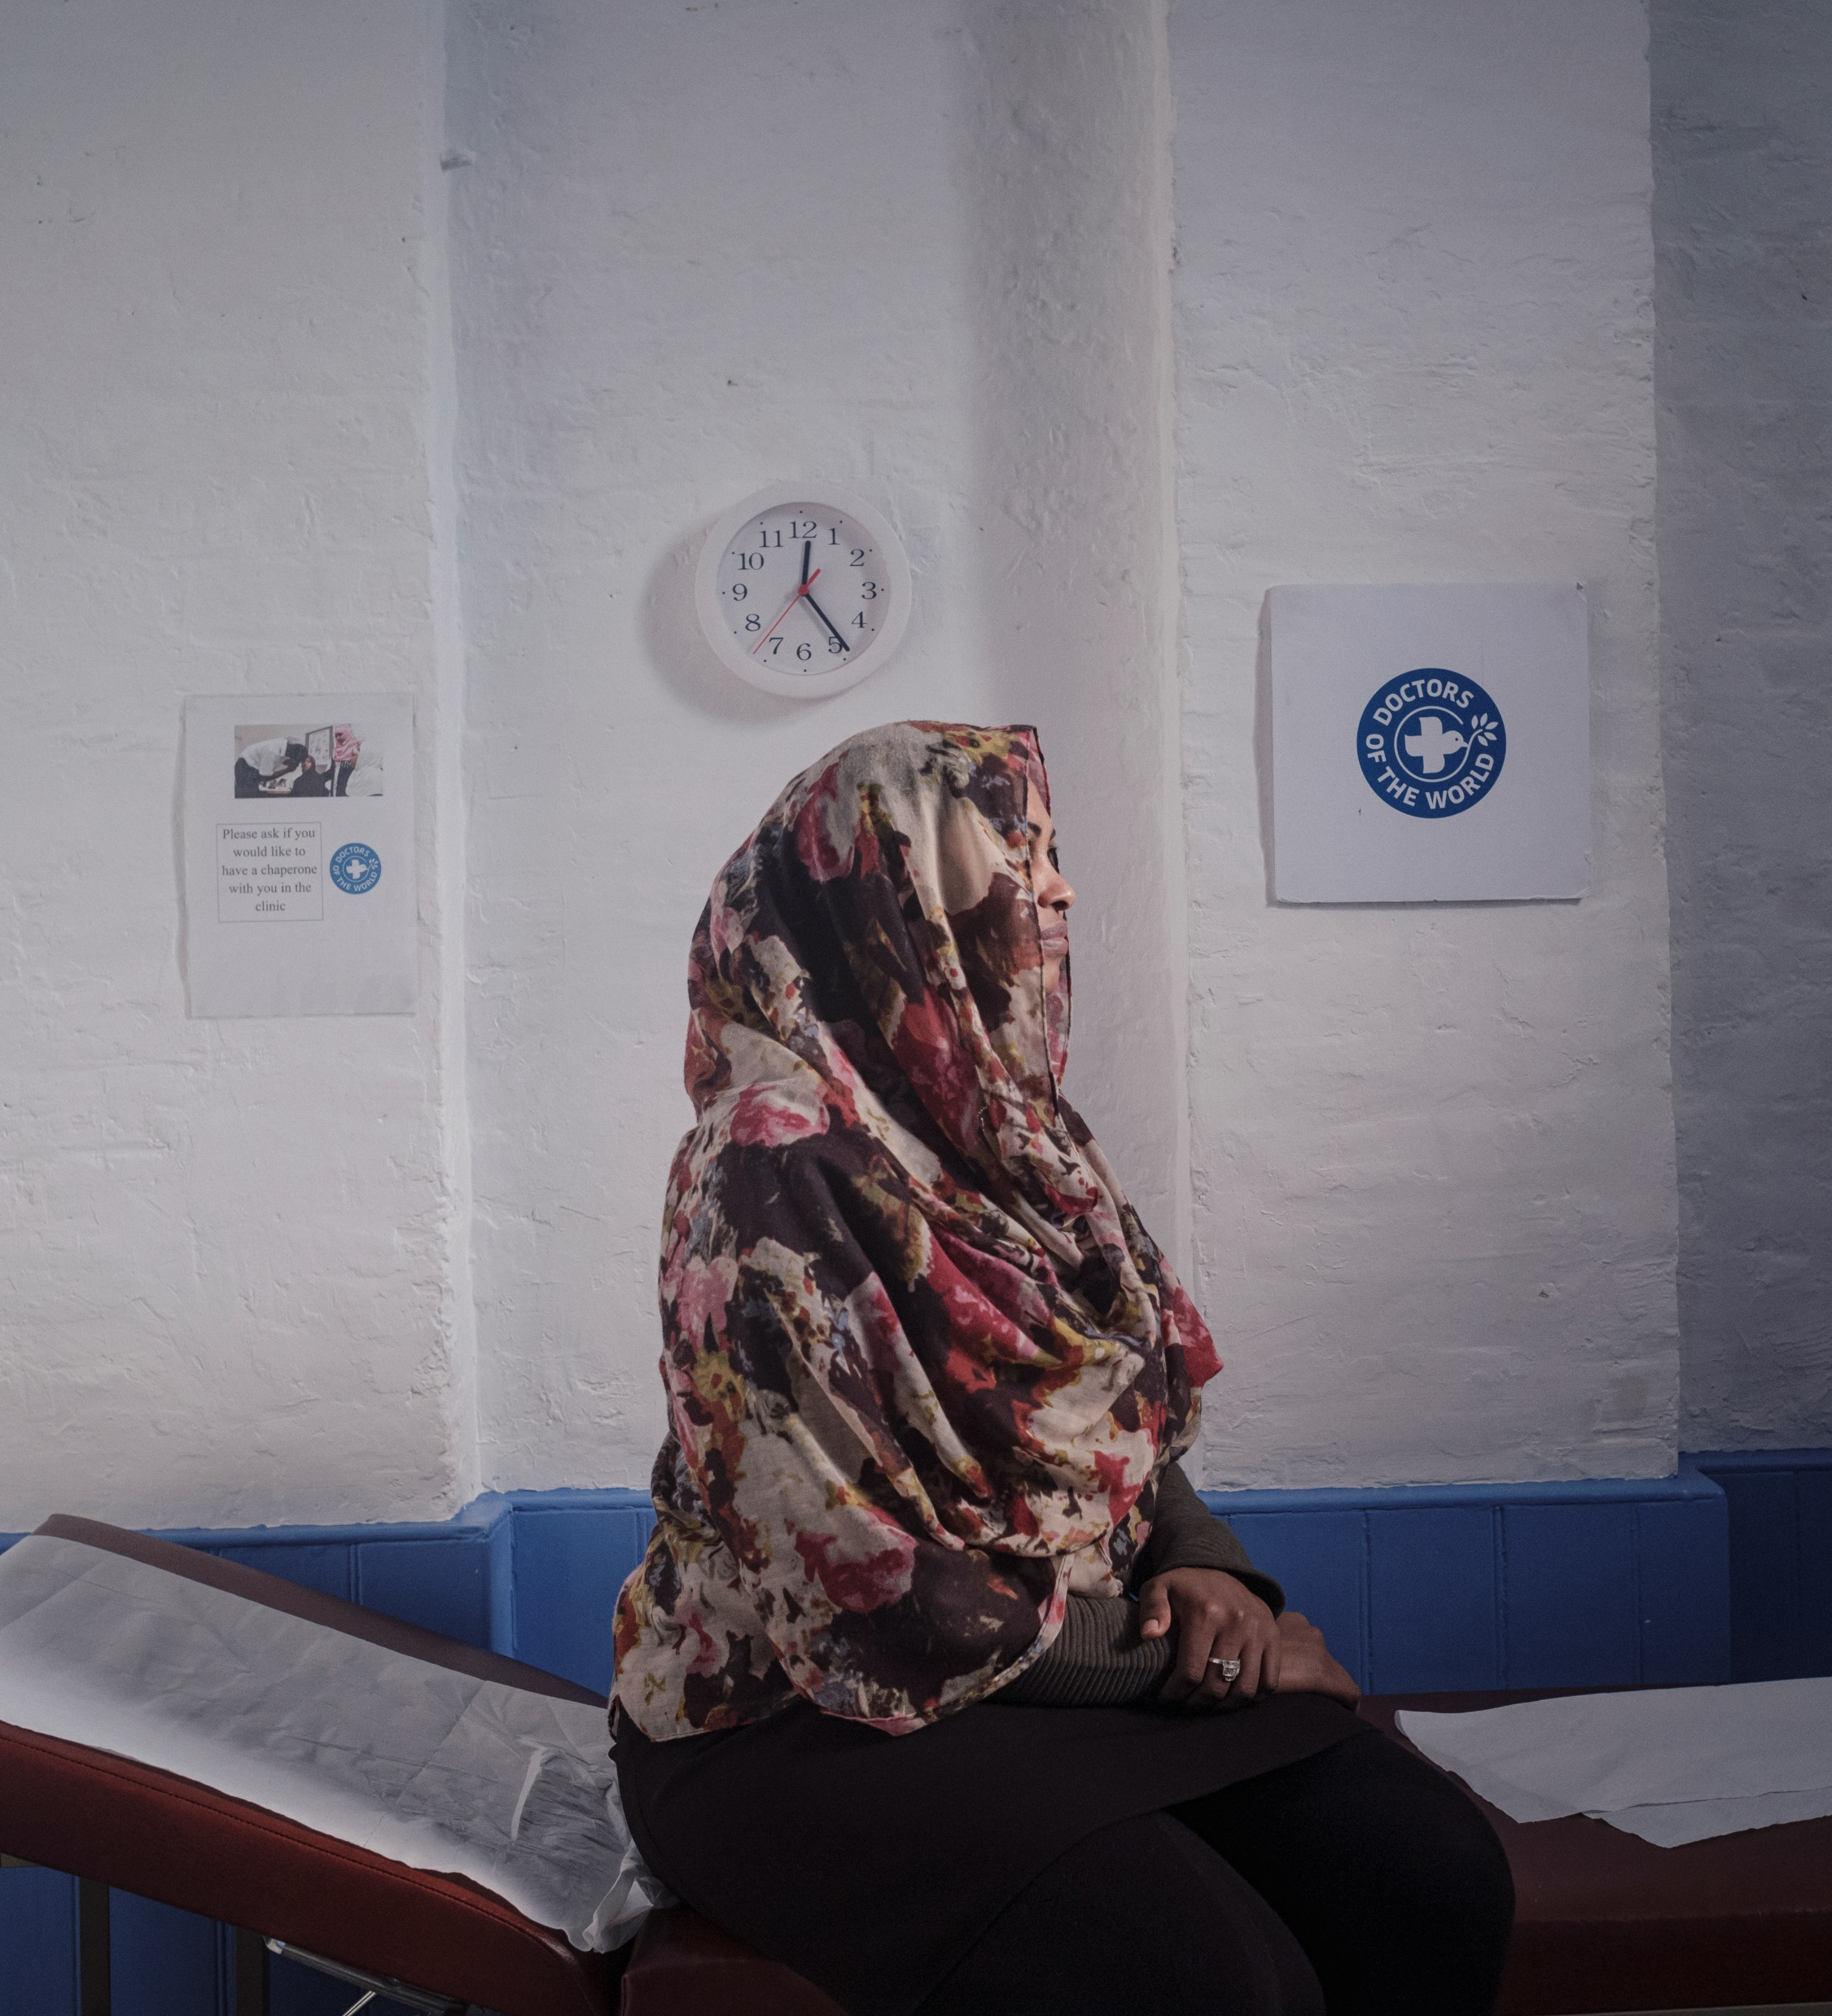

Barriers to accessing healthcare
Miriam was turned away from registering with a GP practice 3 times
She was 29 weeks pregnant before first antenatal appointment
She came to DoTW clinic and was supported to register with a GP in the area where she was staying
What were the barriers Miriam likely faced in registering with a GP?
How could you support Miriam in the practice?

Slide 12









Barriers to accessing healthcare
Accessibility: language, literacy, digital, telephone
Lack of knowledge on navigating the NHS/entitlement
Immigration status checks, fear of data sharing and Home Office reporting
Lack of ID or proof of address
Fear /experience of judgement and prejudice
Lack of funds for suitable transport to attend appointments

Slide 13
NHS England guidance
Practices should ensure there is equitable access for all patients who wish to register with them
Anyone in England can register and consult with a GP without charge
Nationality & immigration status are not relevant to GP registration
There is no requirement for proof of ID, address or NHS number to register
Patients without a fixed address can register using the practice address (or alternative address)
If there is uncertainty on the length of time a patient is in the area e.g. asylum seekers in Home Office accommodation -> permanent patient registration
https://www.england.nhs.uk/publication/primary-medical-care-policy-and-guidance-manual-pgm/
Notes:
Practices should ensure there is equitable access for all patients who wish to register with them. Registration should be available to all patients every day during opening hours. Patients should be able to register via a paper form (new PRF1 form) or online and this should be made clear
(The GMS1 form is being phased out and will not be available to order from the PCSE website from 31 October 2024)
Anyone in England may register and consult with a GP without charge.
This includes all asylum seekers and refugees, overseas visitors, students, people on work visas and those who are homeless, whether lawfully in the UK or not, are eligible to register with a GP practice.
A patient does not need to be ‘ordinarily resident’ in England to be eligible for NHS primary medical care (this only applies for secondary care).
There is no regulatory requirement to prove identity, address, immigration status or the provision of an NHS number in order to register
Lack of proof of address/ID “would not be considered reasonable grounds to refuse to register a patient” or withhold appointments.
An alternative address can be used for people with no fixed address or who are afraid to share their address.
This is a "care of" address which can be the practice address or another address such as a place of worship or community centre, or an address which the local authority has provided to the patient to use.
Practices should try to ensure they have a way of contacting the patient if they need to (for example with test results)
There are very limited circumstances in which registration can be refused: if a practice is not taking on new patients (agreed with commissioners), only accepting patients in the practice boundary, or other exceptional circumstances Any registration refusals should be recorded, communicated to patients and made available to commissioners on request.
In some cases a prospective patient may not know how long they will reside in an area. People seeking asylum housed in Home Office commissioned “initial” accommodation may be accommodated in these settings for extended periods of time.
“…where there is uncertainty over the length of time that a patient may be residing in an area, but this is likely to be months rather than weeks, NHS England advises that the patient should be registered as a permanent patient.”
This is important for continuity of care, ongoing medical records and to generate an NHS number if patients do not have one already.

Slide 14
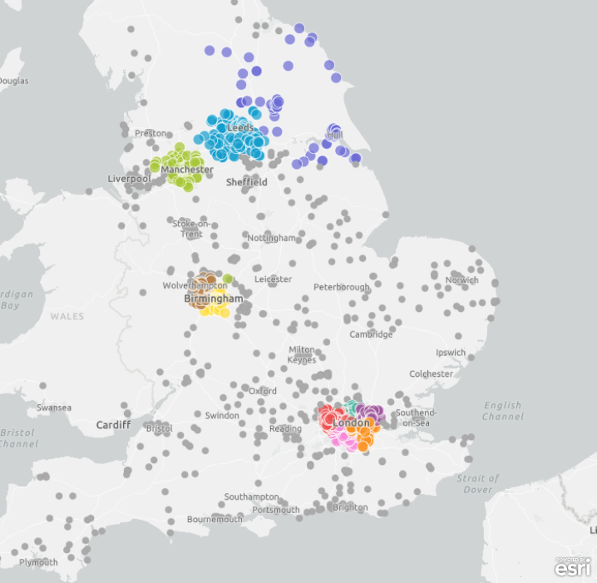
What can be done?
Building an expert community against health exclusion
A network of GP practices demonstrating adherence to NHS England guidance and making commitments to tackle barriers to healthcare faced by underserved communities
Launched by DOTW in 2018, in partnership with primary care - recognising pressures and increasing workloads facing GP practices
Free training, resources and support
2,500+ Safe Surgeries across the UK…

Slide 15
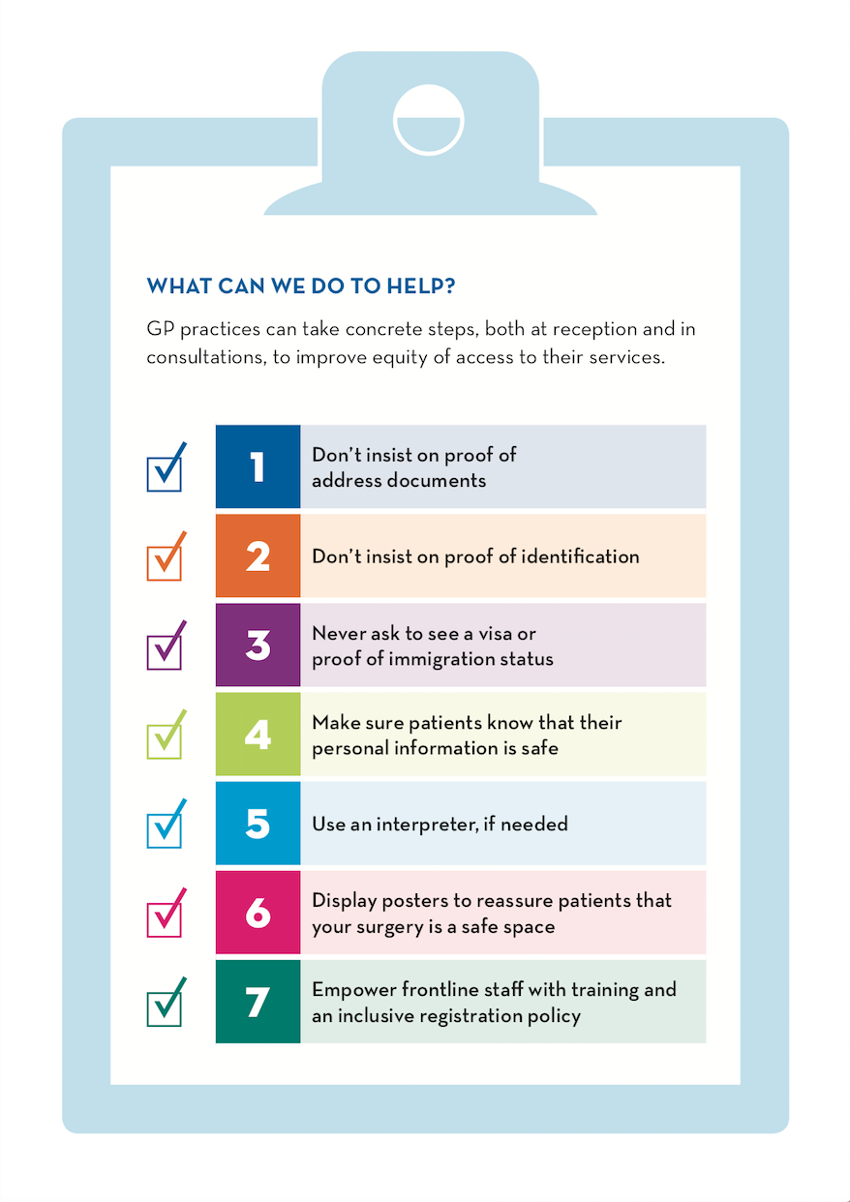

7 steps for safe registration
https://www.doctorsoftheworld.org.uk/safesurgeries/safe-surgeries-toolkit/

Slide 16
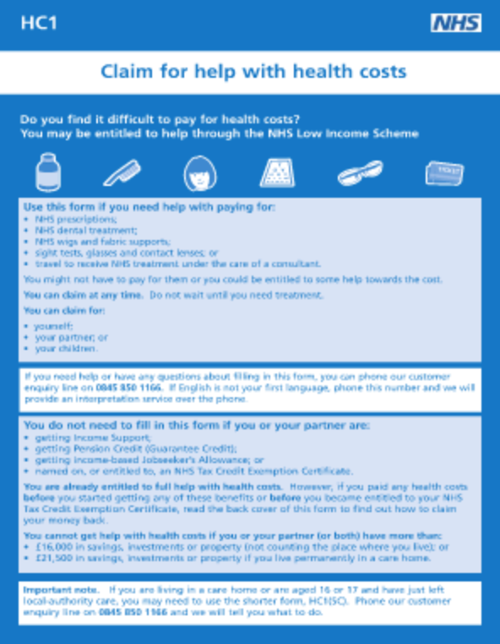
Help with health costs
Objectives
Anyone – regardless of immigration status – can apply for a HC2 certificate
Free NHS prescriptions, dental treatment and sight tests
Keep copies of the HC1 form in the reception area
Refer patients to organisations who can support completion of the HC1 form
Order HC1 forms in bulk from PCSE Online portal
Guidance for supporting application for people seeking asylum
Advice in other languages
https://www.nhsbsa.nhs.uk/nhs-low-income-scheme/hc2-certificates-full-help-health-costs

Slide 17
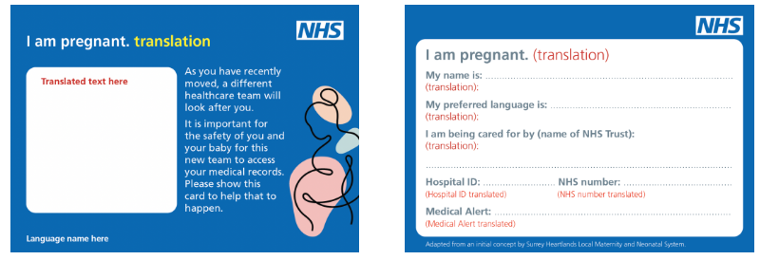
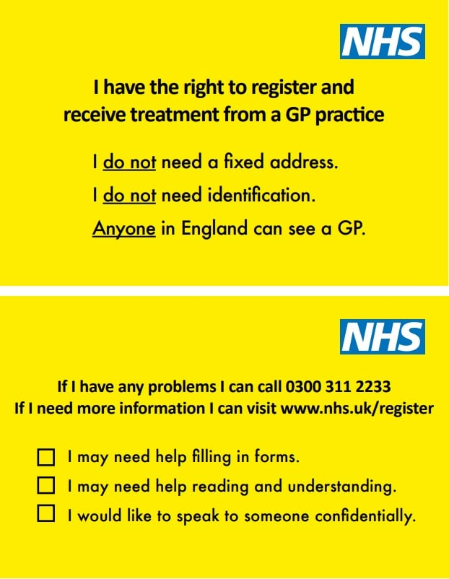
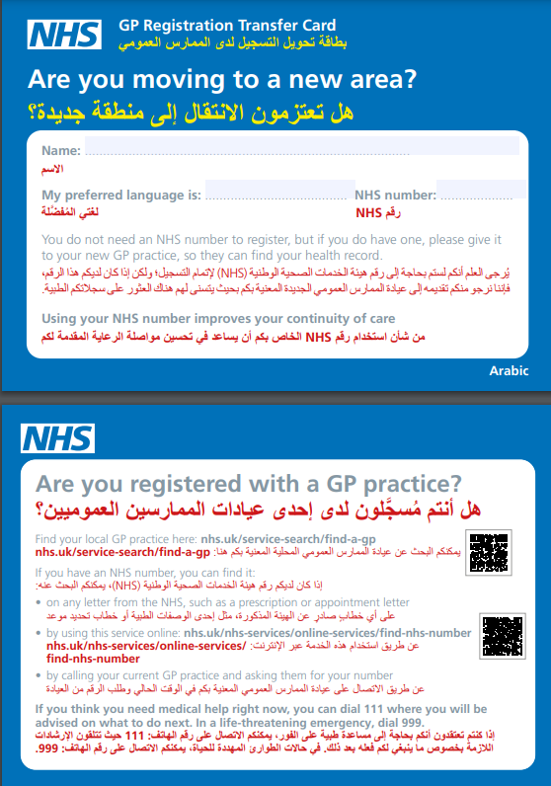
Advocacy cards

Slide 18
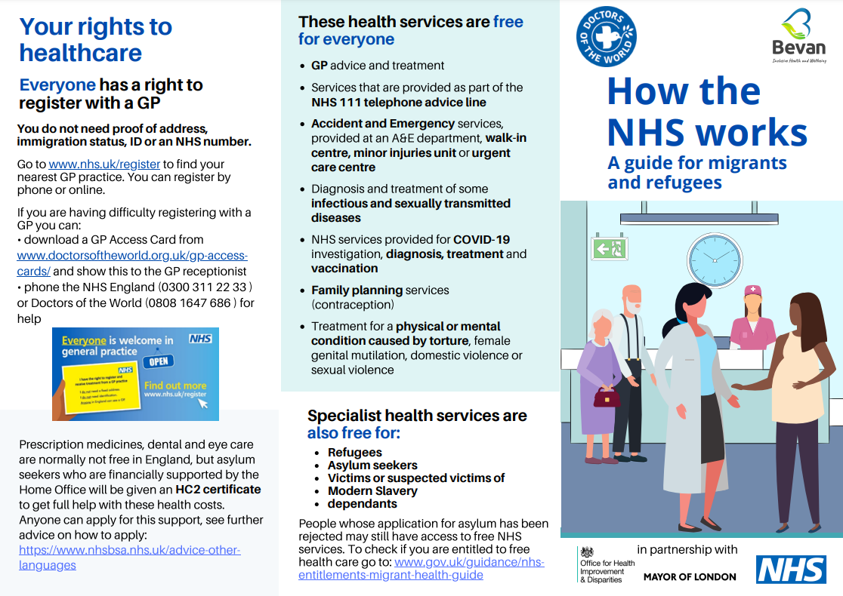
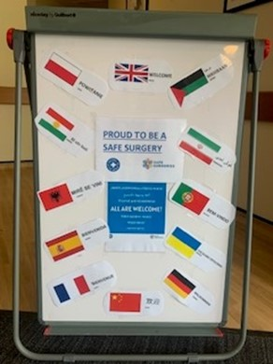
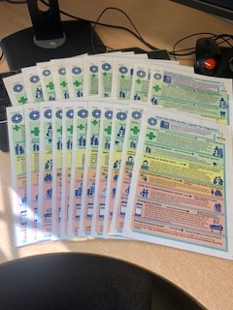
Translated resources
Objectives
DOTW Translated Resources
Navigating the NHS and Right to Health care
How to register with a GP
Right to hospital care
https://www.doctorsoftheworld.org.uk/translated-health-information/?_language=

Slide 19
Secondary care charges
There are restrictions on some secondary care services depending on ordinary residence
Undocumented migrants are charged for some services – this includes some refused asylum seekers in England
Some services are always free or must not be withheld - “Urgent or immediately necessary” treatment to be provided regardless of ability to pay
Some groups are exempt
GP practices must ALWAYS refer patients to secondary care regardless of immigration status
4.4.2 Where a GP refers a patient for secondary services (hospital or other community services) they should do so on clinical grounds alone; eligibility for free care will be assessed by the receiving organisation.
4.4.3 The absence of any reciprocal arrangements between the nation-states, a patient’s nationality is therefore not relevant in giving people entitlement to register as NHS patients for primary medical services.
New guidance – updated September 2023
https://assets.publishing.service.gov.uk/government/uploads/system/uploads/attachment_data/file/1186860/nhs-cost-recovery-overseas-visitors_september2023.pdf

Slide 20
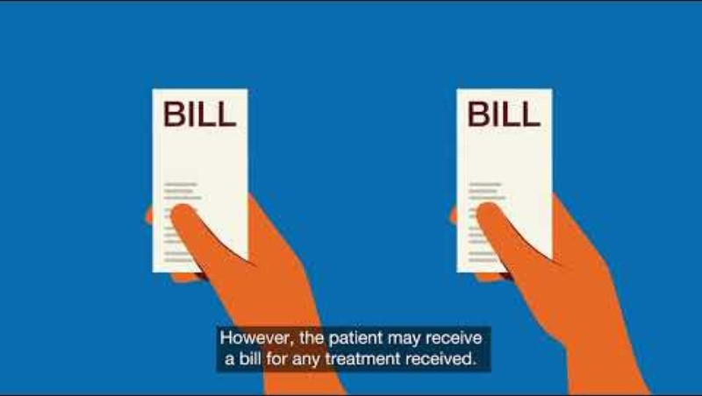
Secondary care charges
https://www.youtube.com/watch?time_continue=14&v=XrqKyH7x4Mg&feature=emb_logo

Slide 21
Ordinary residence
Patients can access free secondary care if they are ordinarily resident (or above exemptions apply)
Residing lawfully and voluntarily in the UK for settled purposes
Case-by-case basis
Anyone who is subject to immigration control cannot be ordinarily resident unless they have Indefinite Leave to Remain, or pre-settled or settled status (EUSS)
An overseas visitor is defined in the Charging Regulations as anyone who is not ordinarily resident in the UK
https://assets.publishing.service.gov.uk/media/60a66068e90e071b566c1f5b/ordinary-residence-tool.pdf
Notes:
Being ordinarily resident broadly means living here on a lawful, voluntarily and settled basis. for the time being - part of the regular order of their life, whether for a long or short duration Anyone who is subject to immigration control (meaning they need permission to enter or remain in the UK, per section 115(9) of the Immigration and Asylum Act 1999), cannot be ordinarily resident in the UK unless they have Indefinite Leave to Remain, or pre-settled or settled status under the EU Settlement Scheme (EUSS).
Being ordinarily resident is not dependent upon nationality, payment of UK taxes, national insurance contributions, being registered with a GP, having an NHS number, having a fixed abode, length of time spent living in the UK, or owning property in the UK

Slide 22
Exempt groups
Refugees and asylum seekers
Some refused asylum seekers
Victims or suspected victims of modern slavery
Children looked after by a local authority
People in prison + immigration detention
People treated under the mental health act
People who have paid the Immigration Health Surcharge
People covered by reciprocal healthcare agreements
Notes:
Refugees – asylum, humanitarian protection and temporary protection including appeals not determined
Refused asylum seekers are exempt in Scotland and Wales
Refused asylum seekers receiving “section 4” support (those destitute and prevented from returning to country of origin), section 21 local authority support, or support under section 1 of Care Act
Victims or suspected victims of modern slavery determined by the Home Office/Human Trafficking Centre (and their dependents) – more on this later
Section 4 support - refused asylum seekers making arrangements for a voluntary departure or there is another temporary barrier to leaving the UK
Children under 18 are not automatically exempt – the person with parental responsibility is liable for the charge
If the person is coming to the UK on a temporary stay of more than 6 months may be required to pay an immigration health surcharge at the time of your visa application.
£1,035 from £600 (recent increase for the Immigration Health Surcharge)

Slide 23
Survivors of trafficking
This includes trafficking in human beings, slavery, servitude, or forced or compulsory labour
Health services are a good place to identify victims of trafficking
The Home Office or UK Human Trafficking Centre provide a letter confirming status of officially recognised as victims / suspected victims (reasonable or positive grounds decision)
Individuals still in a trafficking situation, those awaiting a decision and those who do not apply to be recognised as a victim are not exempt from charges
If you suspect your patient is a victim of slavery or trafficking, talk to your safeguarding lead for advice.
https://assets.publishing.service.gov.uk/government/uploads/system/uploads/attachment_data/file/480631/slavery_guidance.pdf

Slide 24
Exempt services
Accident and emergency services
Diagnosis of some communicable disease (e.g. HIV, TB)
Screening, diagnosis and treatment of sexually transmitted infections
Family planning services
Services provided to treat physical or mental illness caused by sexual or domestic violence, FGM, or torture
Services provided by GPs, school nurses and health visitors
NHS 111
Palliative care provided by a registered palliative care charity

Slide 25
Urgent or immediately necessary?
Urgent and immediately necessary care must be given regardless of ability to pay but patient will be charged after receiving care
Decision made by treating clinician (not OVM)
Care should not be withheld until the clinician confirms that it is non-urgent care (see Clinical patient assessment form).
Diagnostics required to establish whether a service is “Urgent” or “immediately necessary” should not be withheld (although are chargeable)

Slide 26






Urgent or immediately necessary?
“Care that cannot wait until the person leaves the UK. Should take into account pain, disability, and the risk of the delay exacerbating their condition.”
Takes into account the date that patient is ‘reasonably expected to leave the UK’, established by OVM – accurate return date essential and can be challenged
“Life saving, will prevent a condition becoming life-threatening or will prevent permanent serious damage.”
Maternity services are always “immediately necessary”.
Everything else is based on the treating clinician's decision
Refused asylum seekers and undocumented migrants often face many obstacles to leaving the UK - assume may not be able to return within 6 months
Example: Undocumented migrant unlikely to leave the UK in the next year with a non-melanoma skin cancer – treatment (cryotherapy) is urgent
Example: Acute renal disease requiring 3x dialysis a week
As treatment is immediately necessary the date on which the patient can reasonably be expected to return home is irrelevant
Immediately necessary
Urgent

Slide 27
Urgent or immediately necessary?
Clinician makes assessment if care is “urgent” or if it can wait
“If the person is unlikely to leave the UK for some time treatment which clinicians might otherwise consider non-urgent is more likely to be considered by them as urgent” (Department of Health guidance)
How to decide if treatment is urgent?
Pain or disability the condition is causing
The risk that delay might require more expensive or involved interventions
The likelihood of a substantial or life-threatening deterioration if treatment is delayed until return to home country

Slide 28
Non-urgent care
If none of the exemptions apply, and the clinician decides the treatment is not urgent or immediately necessary -> non-urgent
Costs recovered up-front
If patients do not pay, treatment will not be provided
Patients can present again for reassessment if their condition changes or return date passes
150% of cost to the NHS

Slide 29
Destitution + ‘writing off’ debt
If a person is destitute or is at risk of imminent destitution relevant bodies can choose not to pursue the debt
Written off debt is not cancelled – may be pursued in the future if circumstances change
Debt can be 'written off' if the individual has passed away and the money cannot be recovered from the individuals’ estate
The debt will still be reported to Home Office and could affect future immigration decisions

Slide 30
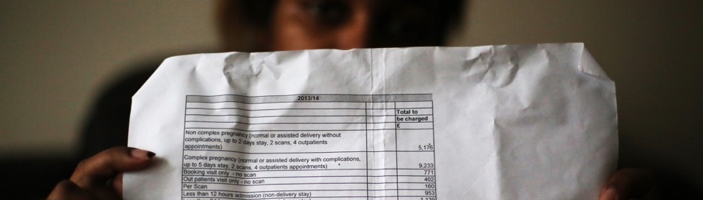
Charging as a barrier to healthcare
Fear makes people avoid healthcare
Exemptions to public health do not work: screening or vaccinations missed (not registered with GP)
Bills and debt collection (people driven into exploitative work to pay bills)
Debts reported to the Home Office and affects future immigration applications and right to travel
Confusion about the rules and poor practice
Incorrect billing
Immediately necessary or urgent treatment often delayed or denied
Patients billed for services that should be exempt e.g. asylum seekers or refugees

Slide 31
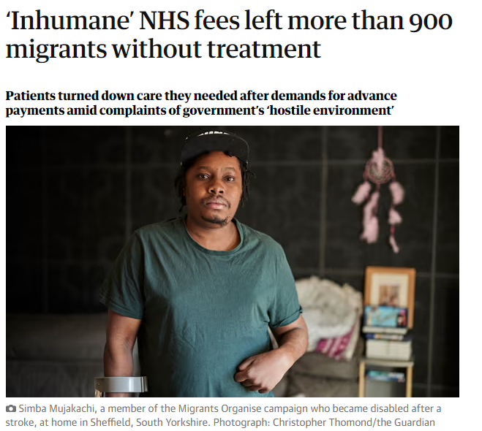
Charging as a barrier to healthcare
Data compiled by the Observer under the Freedom of Information Act shows that, since January 2021, 3,545 patients across 68 hospital trusts in England have been told they must pay upfront charges totalling £7.1m.
Of those, 905 patients across 58 trusts did not proceed with treatment.
https://www.theguardian.com/uk-news/2023/aug/20/inhumane-nhs-fees-left-more-than-900-migrants-without-treatment

Slide 32
Impact of NHS charging
Case Study: Miriam
At the hospital the Overseas Visitors Manager identifies Miriam as an undocumented migrant.
She is sent an invoice for her ANC.
Is the Overseas Visitors Manager correct?

Slide 33
Impact of NHS charging
Is the Overseas Visitors Manager correct?
As un undocumented migrant, Miriam was chargeable for secondary care, but:
Maternity services are ‘immediately necessary’ so should not be denied, delayed or discouraged.

Slide 34
Case study: Omar
At the hospital the Overseas Visitors Manager identifies Omar as an undocumented migrant.
The hospital refuses treatment unless Omar’s family pays in advance.
They cannot afford to pay and request to pay in instalments is denied.
Omar is discharged without treatment.
Is the Overseas Visitors Manager correct?

Slide 35
Case study: Omar
As an undocumented migrant he is chargeable. But:
Clinician had discretion to identify the treatment for his tumour as ‘immediately necessary’.
  Omar could be treated first and pay later.
The OVM had the discretion to set up a manageable payment plan, allowing his family to pay in instalments.
Following discharge, Omar’s GP issued repeat prescriptions for painkillers.
Omar came to DOTW’s clinic 3 years later in constant pain, dependent on painkillers and with visible wasting of his left arm.
Following a challenge by DOTW, the hospital finally agreed that treatment was U/IN and began treatment.

Slide 36
Supporting chargeable patients
Make patients aware that they may be charged for treatment for which they are referred, but do not discourage treatment
Is your patient exempt from charges?
If your patient falls into the following groups/exemptions, include in a referral letter or inform the OVM:
asylum seekers, refugees, or victims of trafficking
treatment for conditions (physical or mental) resulting from torture, sexual abuse, domestic abuse or FGM
diagnostics/treatment for communicable disease or family planning
Urgent and immediately necessary care
Trusts often fail to identify these exemptions correctly and charge patients but clinical staff (including GPs) can play a role in informing OVMs
Encourage engagement with care, particularly antenatal care
Follow up with patients and identify local support
e.g. to help patients get to appointments

Slide 37
Refer to DOTW
If your patient is refused treatment:
Refer to DOTW’s casework team
Doctors of the World’s advice line on freephone 0808 1647 686
If you’re calling from an organisation, please call our clinic office line: 0207 0789 629 or email clinic@doctorsoftheworld.org.uk
More information here
How we can support:
Advocate for those denied secondary care
Advice for individuals and their families to navigate a complex system
Write to OVMs and debt management companies for destitute people; proactively requesting manageable repayment plans
Signpost to debt advice, immigration advice and other support.
Explain the implications of not engaging with NHS debt
Report on the harm caused by NHS charging

Slide 38
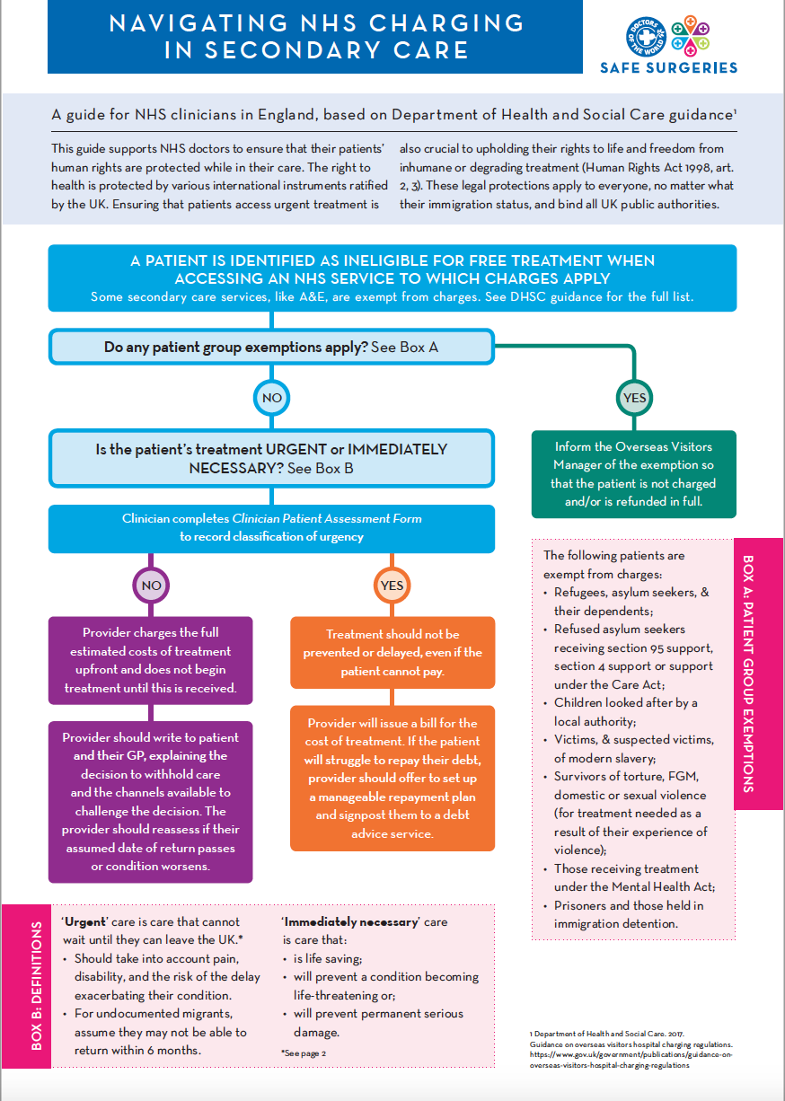
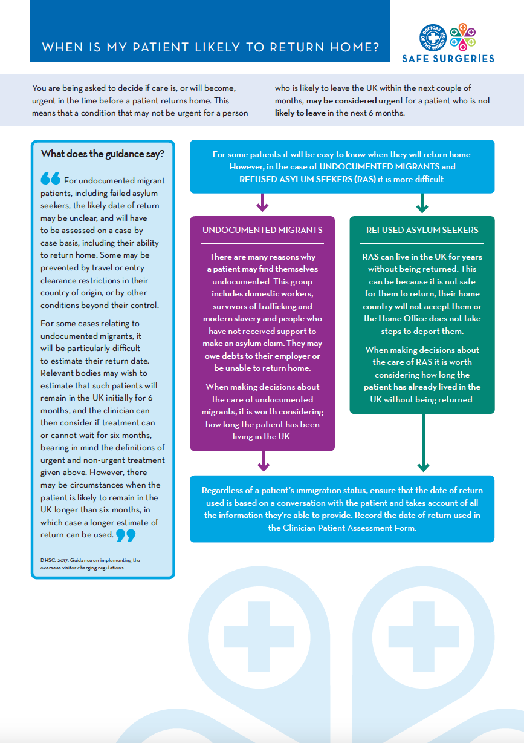
Navigating NHS charging
https://www.doctorsoftheworld.org.uk/wp-content/uploads/2019/05/urgent_care_guidelines.pdf

Slide 39
Find out more https://www.doctorsoftheworld.org.uk/safesurgeries/
Feedback
Please complete our training evaluation form
Translated health information https://www.doctorsoftheworld.org.uk/translated-health-information/
Contact us safesurgeries@doctorsoftheworld.org.uk
DOTW clinic https://www.doctorsoftheworld.org.uk/patient-clinic/
Volunteer with us https://www.doctorsoftheworld.org.uk/jobs-and-volunteer-roles/
Stay connected

Slide 40
Resources
Primary care
Secondary care
Safe Surgeries guidance & resources.
NHS England guidance on GP Registration
BMA guidance on GP registration
BMA refugee and asylum seeker patient health toolkit
CQC guidance on refugees, asylum seekers, and other migrants
Migrant Health Guide
Inclusion Health Self Assessment Tool for PCNs
DH Guidance on implementing charging
Upfront charging framework and clinical case studies
Navigating NHS Charging in Secondary Care – DOTW
Supporting families facing NHS charging – flowchart
Improving access to maternity care

