Slide 1
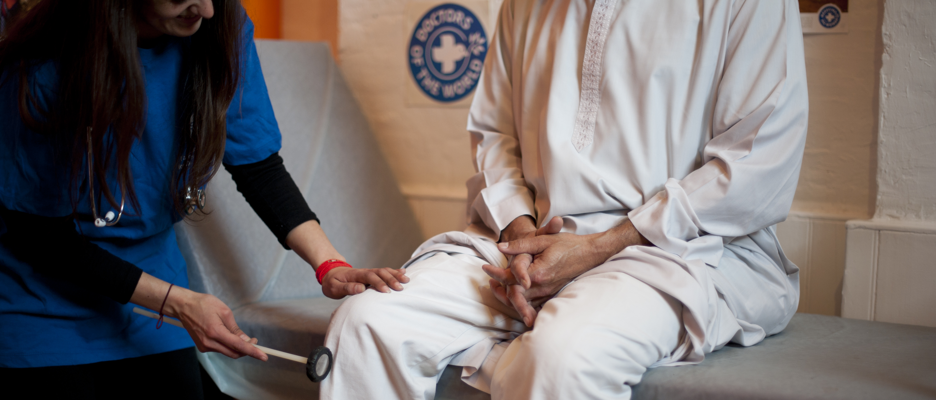

SAFE SURGERIES
Improving access to primary care and GP registration
Doctors of the World UK, part of the Médecins du Monde network

Slide 2
Objectives
Discuss the importance of universal healthcare access
Be aware of the barriers to healthcare access impacting underserved communities
Understand entitlements to NHS primary care in England
Know what good practice is to promote inclusive GP registration processes, in line with NHS England guidance
Take practical steps to implement Safe Surgeries recommendations in your practice to improve access and reduce health inequalities

Slide 3

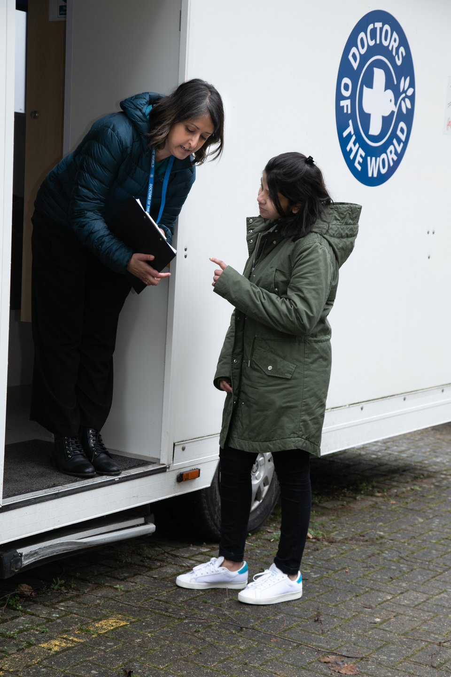
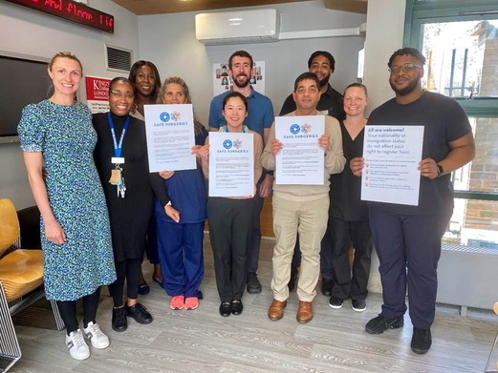
Our work in the UK
SUPPORTING GP PRACTICES
Safe Surgeries initiative: network of GP practices across the UK working to improve registration processes and reduce health inequalities
ADVOCATING FOR CHANGE
DIRECT SUPPORT TO INDIVIDUALS
Supported by our volunteer team of 35 Experts by Experience we aim to make systemic changes to how those currently excluded from healthcare can access health services
Our team of volunteer doctors, nurses and caseworkers provide medical advice and support to people in the UK who cannot access healthcare through our primary care clinic and advice line

Slide 4
Importance of GP registration
Safe discharge
Long-term follow up and continuity of care
Efficient use of services
Patients who face barriers to GP registration may attend A+E if issues become acute/not integrated into NHS services
Public health
Prevention and early detection of disease
Vaccination + screening programmes
Health equity
Cost effective
Promotes a fairer society
Financial + human cost of delayed access to care and preventative interventions
Core principle of the NHS is that it provides a ‘comprehensive service, available to all’
Human rights - UK is bound to give equal access to the right to health for all persons

Slide 5

Inclusion health
Inclusion health is a ‘catch-all’ term used to describe people who are socially excluded, typically experience multiple overlapping risk factors for poor health, experience stigma and discrimination, and are not consistently accounted for in electronic records
Inclusion Health groups are not a homogenous group and may be facing a wide variety of experiences
People from Inclusion Health groups are more likely to experience health inequalities and barriers to public services
Underserved groups face significant barriers in accessing healthcare
People with insecure immigration status
People experiencing homelessness
People from Gypsy, Roma and Traveller communities
People who sell sex
Survivors of modern day slavery
People who have experienced domestic violence
People recently released from prison
People with learning disabilities

Slide 6
Immigration status
Asylum seeker
A person who has left their country of origin and applied for asylum in another country but whose application has not yet been concluded.
Refused asylum seeker
A person whose asylum application has been unsuccessful
Refugee
Undocumented migrant
Someone who enters or stays in the UK without the documents required under immigration regulations.
Someone whose asylum application has been successful. The Government recognises they are unable to return to their country of origin owing to a well-founded fear of being persecuted

Slide 7
Immigration status
‘Undocumented’ migrants find themselves without the right documents for a variety of reasons, often beyond their control.
Survivors of trafficking
People who came to UK to work without a visa
People who came to the UK as children with undocumented parents
People whose visa has expired (student/ working)
Refused asylum seekers
People who don’t claim asylum due to lack of legal advice
People on spousal visas whose relationship breaks down
Domestic workers on expired visas which their employer doesn’t renew

Slide 8

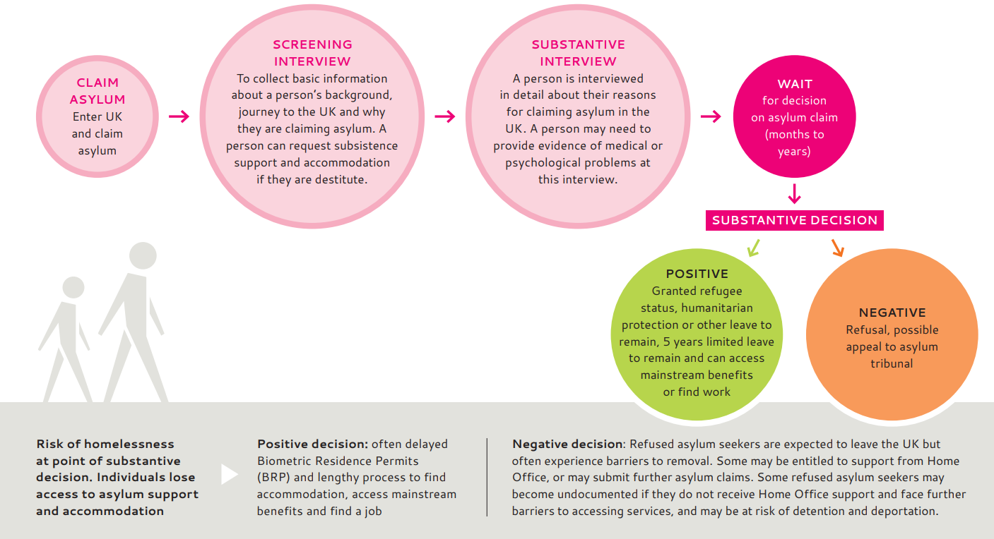
Asylum process
https://www.doctorsoftheworld.org.uk/wp-content/uploads/2025/06/clinician-toolkit-final.pdf

Slide 9
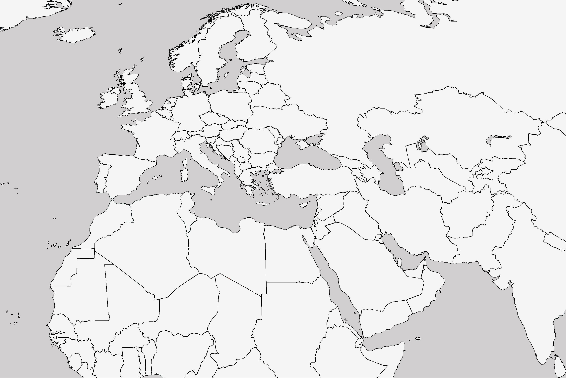
Barriers to accessing healthcare
Street homeless in London, after 2 months taken to a church by a lady she met on the street.
Smuggled to “the Jungle” in Calais and then to London
Imprisoned in Libya; became a street homeless and a victim of sexual assault in Italy.
Miriam (28) fled Eritrea after escaping conscription into national military service.
Notes:
Miriam is a 28 year old lady who fled Eritrea after escaping conscription into national military service. She had been abused, raped and denied medical treatment. She travelled through Sudan, to Libya and then on to Italy.
She was imprisoned in Libya, street homeless in Italy and raped by a group of young men. She was smuggled to ‘the Jungle’ in Calais; by this point her mental health was deteriorating: ‘At that moment I was having a lot of stress…maybe I was screaming, things like that’
She was smuggled into the UK. She was street homeless in London and then after 2 months was taken to a church by a lady she met on the street. “I started to beg her, my feet were swollen and I had been walking up and down for 2 days. I hadn’t showered and I hadn’t eaten well. She could see that I was pregnant”. She was allowed to sleep in the church. Members of the congregation bring her food, and sometimes they let her stay with them.

Slide 10
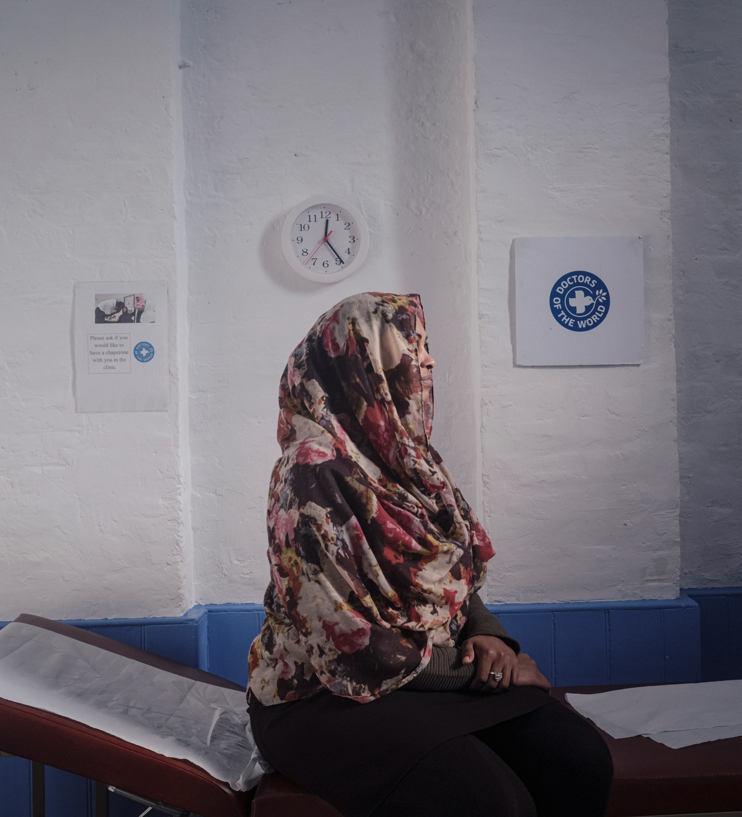

Barriers to accessing healthcare
Miriam was turned away from registering with a GP practice 3 times
She was 29 weeks pregnant before first antenatal appointment
She came to DoTW clinic and was supported to register with a GP in the area where she was staying
What were the barriers Miriam likely faced in registering with a GP?
How could you support Miriam in the practice?

Slide 11
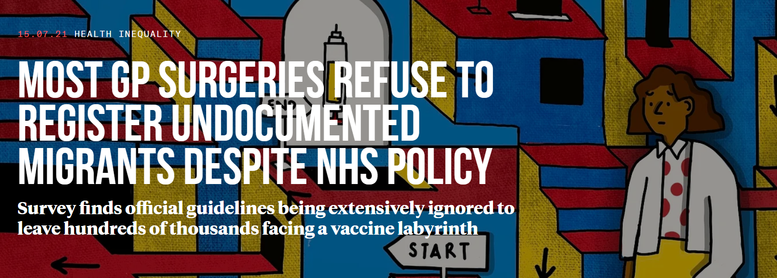


The Bureau contacted around 1/3 of GP practices in 10 locations across the UK. They asked about registering a hypothetical patient: “Rosa”, a woman in her 40s without ID or proof of address:
62% said they would not register the patient
14% were unsure
Only 24% of GP surgeries surveyed in the UK would register someone without proof of address, ID or legal immigration status
https://www.thebureauinvestigates.com/stories/2021-07-15/most-gp-surgeries-refuse-to-register-undocumented-migrants

Slide 12









Barriers to accessing healthcare
Accessibility: language, literacy, digital, telephone
Lack of knowledge on navigating the NHS/entitlement
Immigration status checks, fear of data sharing and Home Office reporting
Lack of ID or proof of address
Fear /experience of judgement and prejudice
Lack of funds for suitable transport to attend appointments

Slide 13


Barriers to accessing healthcare
Proof of ID or address?
People who are undocumented
Survivors of trafficking or modern slavery
Children born in the UK to parents without documentation
People who cannot afford to renew documents e.g. passport
People fleeing domestic abuse staying with friends, family or in a shelter
People working in exploitative situations whose’ employer has taken their documents
People seeking asylum and refugees who have lost documents during their journey to the UK
People who have submitted documents to the Home Office for application
People living on a boat
People with no fixed address (unstable accommodation, sofa-surfing, street homeless
Young people leaving care

Slide 14
NHS England guidance
Nationality and immigration status are not relevant to GP registration
Anyone in England may register and consult with a GP without charge.
This includes all asylum seekers and refugees, overseas visitors, students, people on work visas and those who are homeless, whether lawfully in the UK or not, are eligible to register with a GP practice.
A patient does not need to be ‘ordinarily resident’ in England to be eligible for NHS primary medical care (this only applies for secondary care).
https://www.england.nhs.uk/publication/primary-medical-care-policy-and-guidance-manual-pgm/

Slide 15
NHS England guidance
Nationality and immigration status are not relevant to GP registration
Anyone in England may register and consult with a GP without charge.
This includes all asylum seekers and refugees, overseas visitors, students, people on work visas and those who are homeless, whether lawfully in the UK or not, are eligible to register with a GP practice.
A patient does not need to be ‘ordinarily resident’ in England to be eligible for NHS primary medical care (this only applies for secondary care).
https://www.england.nhs.uk/publication/primary-medical-care-policy-and-guidance-manual-pgm/

Slide 16
NHS England guidance
Documentation for registration?
There is no regulatory requirement to prove identity, address, immigration status or the provision of an NHS number in order to register
Lack of proof of address/ID “would not be considered reasonable grounds to refuse to register a patient” or withhold appointments.
The guidance states, "If a patient cannot produce any supportive documentation but states that they reside within the practice boundary then practices should accept the registration"
NHS numbers are not required for registration
Some individuals new to the country are automatically attributed an NHS number but may not know it. Checking the Spine to see if individuals already have an NHS number ensures continuity of care and avoids duplication of records.
https://www.england.nhs.uk/publication/primary-medical-care-policy-and-guidance-manual-pgm/

Slide 17
NHS England guidance
People with no fixed address
An alternative address can be used for people with no fixed address or who are afraid to share their address.
This is a "care of" address which can be the practice address or another address such as a place of worship or community centre, or an address which the local authority has provided to the patient to use.
Practices should try to ensure they have a way of contacting the patient if they need to (for example with test results)
https://www.england.nhs.uk/publication/primary-medical-care-policy-and-guidance-manual-pgm/

Slide 18
NHS England guidance
Registration refusal
There are very limited circumstances in which registration can be refused: if a practice is not taking on new patients (agreed with commissioners), only accepting patients in the practice boundary, or other exceptional circumstances.
Any registration refusals should be recorded, communicated to patients and made available to commissioners on request.
What about fraud?
If a practice suspects a patient of fraud (such as using fake ID) then they should register and treat the patient but hand the matter over to the NHS Counter Fraud Authority (NHSCFA)
https://www.england.nhs.uk/publication/primary-medical-care-policy-and-guidance-manual-pgm/

Slide 19
NHS England guidance
Permanent or temporary registration?
In some cases a prospective patient may not know how long they will reside in an area. People seeking asylum housed in Home Office commissioned “initial” accommodation may be accommodated in these settings for extended periods of time.
“…where there is uncertainty over the length of time that a patient may be residing in an area, but this is likely to be months rather than weeks, NHS England advises that the patient should be registered as a permanent patient.”
This is important for continuity of care, ongoing medical records and to generate an NHS number if patients do not have one already.
https://www.england.nhs.uk/publication/primary-medical-care-policy-and-guidance-manual-pgm/

Slide 20
NHS England guidance
Access to registration
Practices should ensure there is equitable access for all patients who wish to register with them.
Registration should be available to all patients every day during opening hours
Patients should be able to register via a paper form (new PRF1 form) or online and this should be made clear
(The GMS1 form is being phased out and will not be available to order from the PCSE website from 31 October 2024)
https://www.england.nhs.uk/publication/primary-medical-care-policy-and-guidance-manual-pgm/

Slide 21
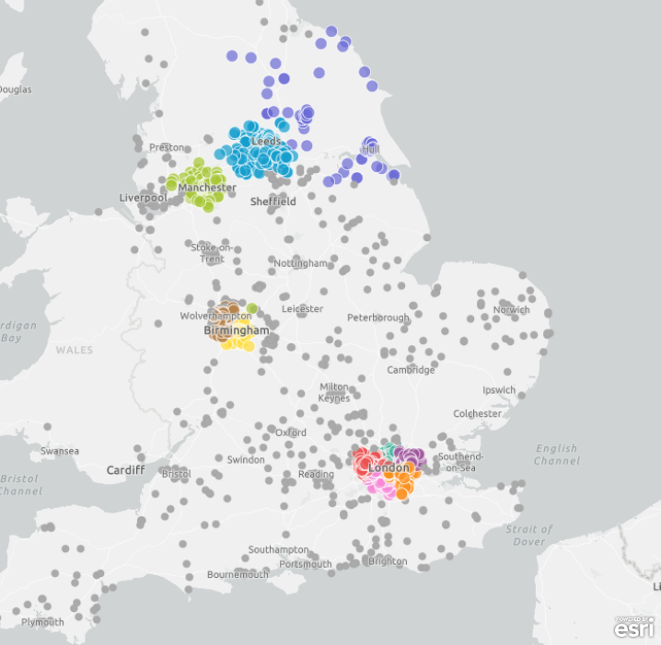
What can be done?
Building an expert community against health exclusion
A network of GP practices demonstrating adherence to NHS England guidance and making commitments to tackle barriers to healthcare faced by underserved communities
Launched by DOTW in 2018, in partnership with primary care - recognising pressures and increasing workloads facing GP practices
Free training, resources and support
2,500+ Safe Surgeries across the UK…

Slide 22
Why become a Safe Surgery?
Comply with NHS policy
Be part of a supportive national network
CQC approved
Improve efficiency and communication in the registration process
Improve patient experience
Meet the needs of your community
Support staff learning and skills building
Share good practice
Ensure lack of documents, immigration status and language do not prevent registration
CQC Equity in Access Framework
We make sure that everyone can access the care, support and treatment they need when they need it. People can access care, treatment and support when they need to and in a way that works for them, which promotes equality, removes barriers or delays and protects their rights.'

Slide 23

Safe Surgeries process
First, register as a Safe Surgery (sign up form here), then complete 5 steps:
1. Sign the Safe Surgeries declaration + nominate practice lead
2. Complete Safe Surgeries training and review resources
3. Review practice registration policy
5. Engage with the Safe Surgeries network and update DOTW
4. Display posters in practice and update website

Slide 24
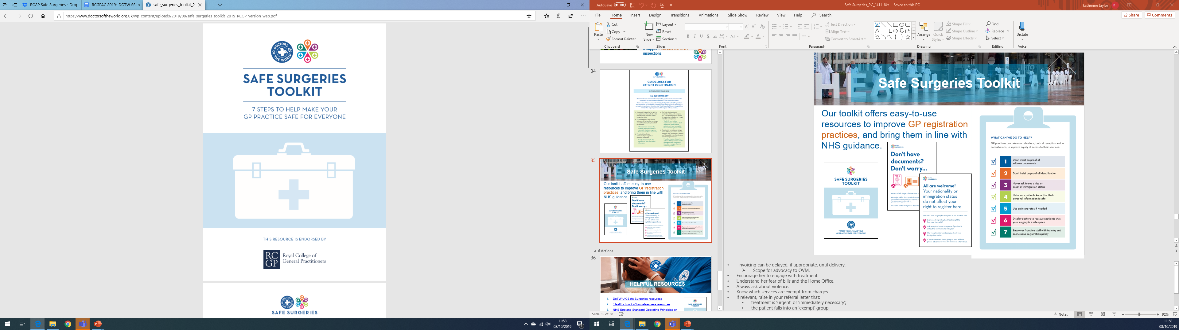
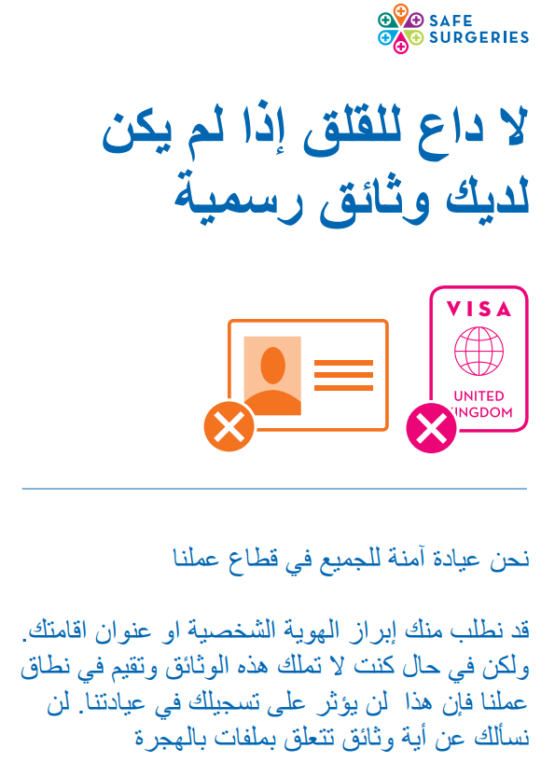
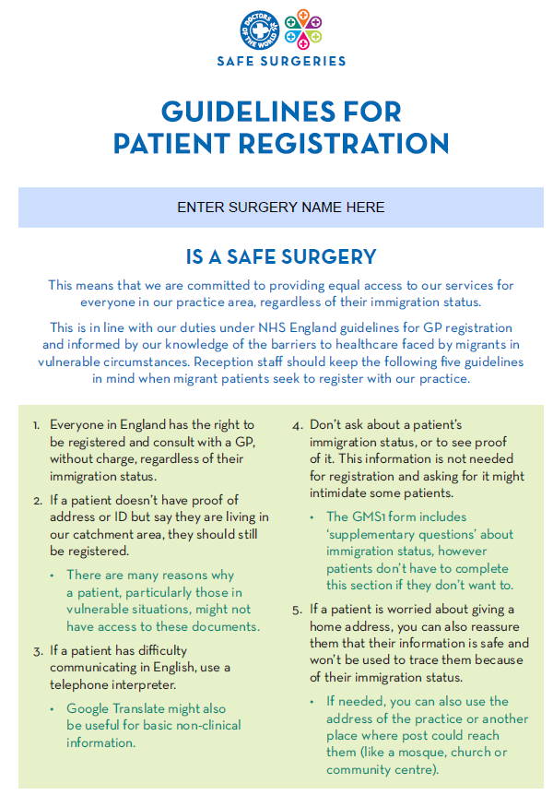

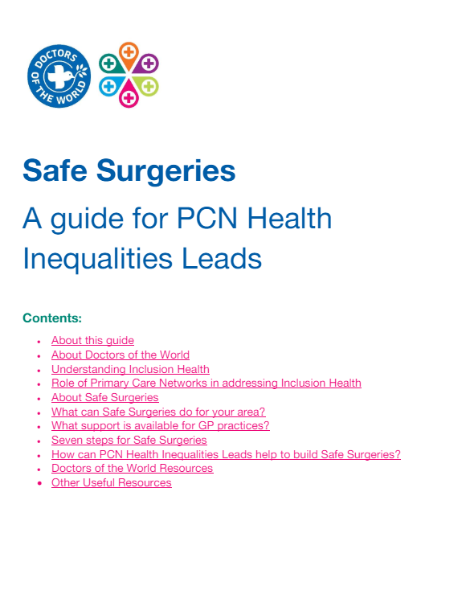
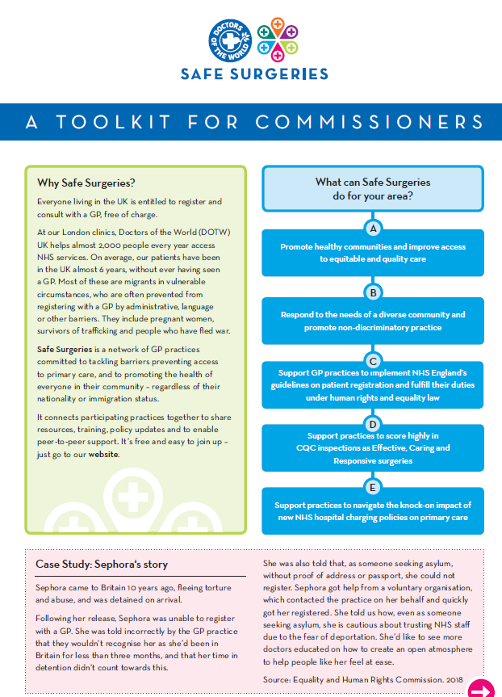
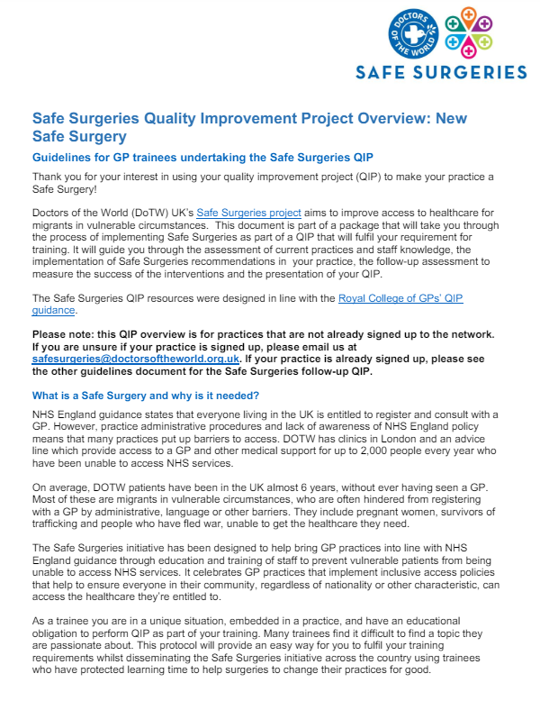

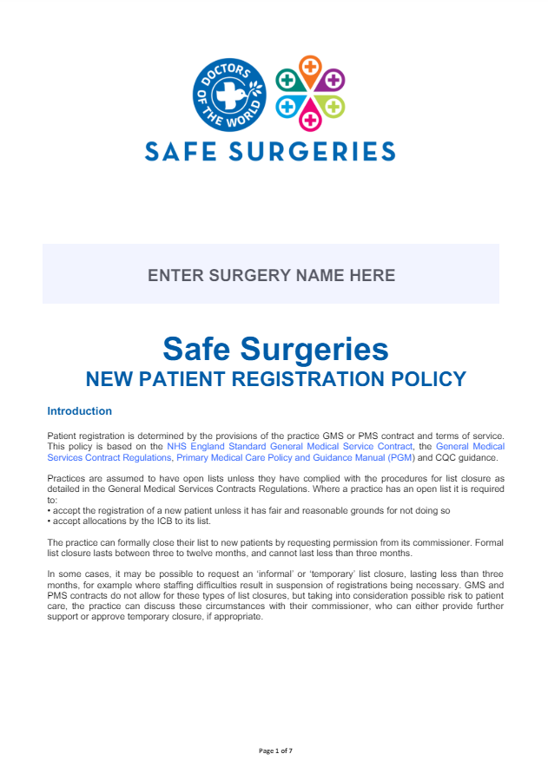
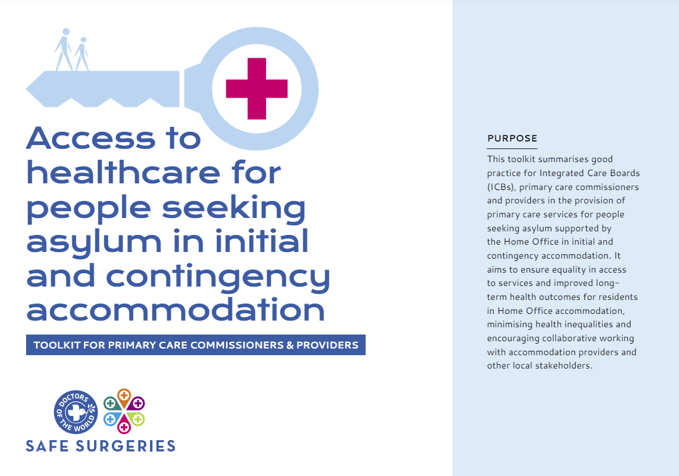
Safe Surgeries resources
https://www.doctorsoftheworld.org.uk/safesurgeries/safe-surgeries-toolkit/

Slide 25
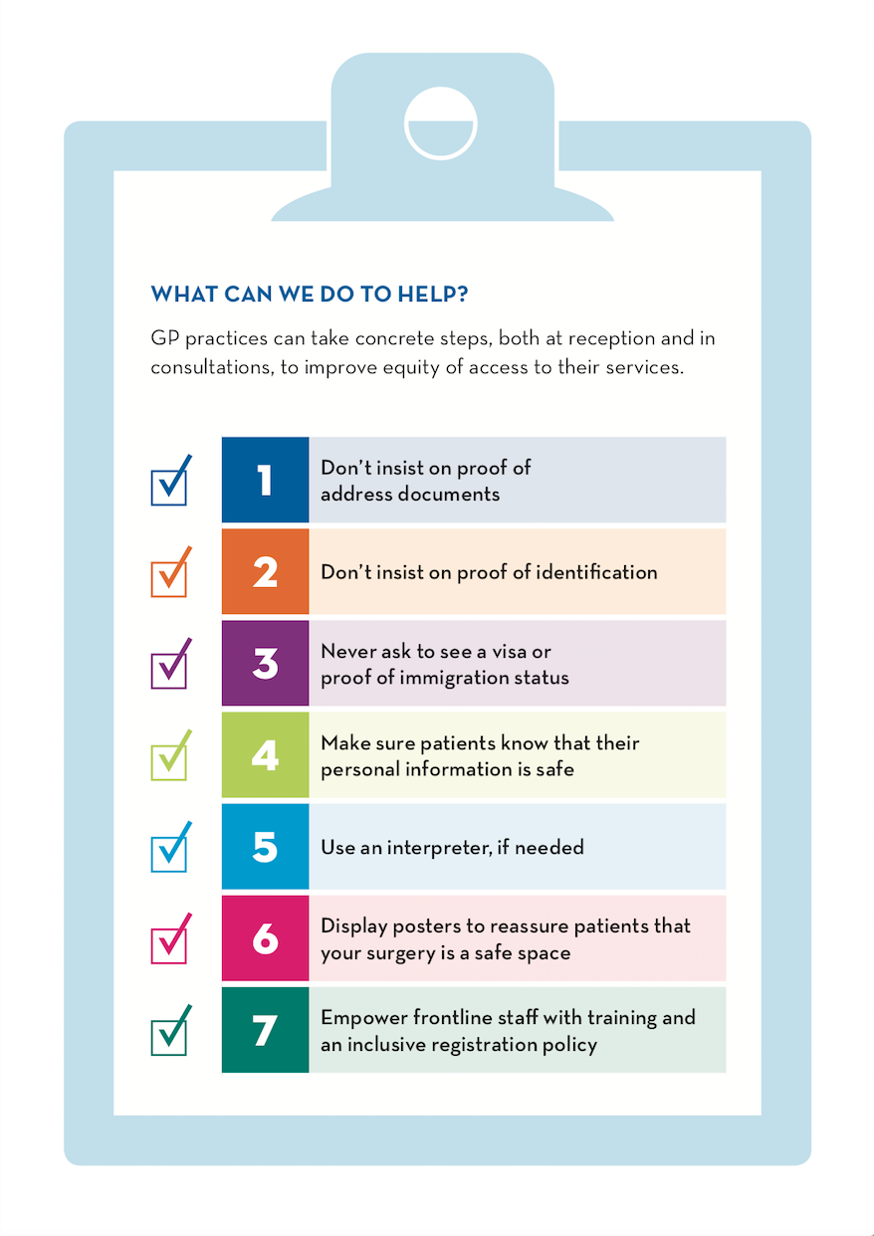

7 steps for safe registration
https://www.doctorsoftheworld.org.uk/safesurgeries/safe-surgeries-toolkit/

Slide 26



Inclusive registration processes
Requests for documents should be flexible and not a requirement
When registering patients with no fixed address, use a full ‘care of’ address with postcode (practice address or alternative address e.g. friend, community centre) - don’t use ‘no fixed abode’
Ensure agreements are in place at the point of registration for patients who do use this option to collect letters & test results and to maintain contact.
Be aware of data-sharing fears by reassuring patients that their information will not be shared without consent
Offer support for the registration process, and promote the option to use interpreting services in reception and in consultations
https://pcse.england.nhs.uk/services/patient-registrations/

Slide 27
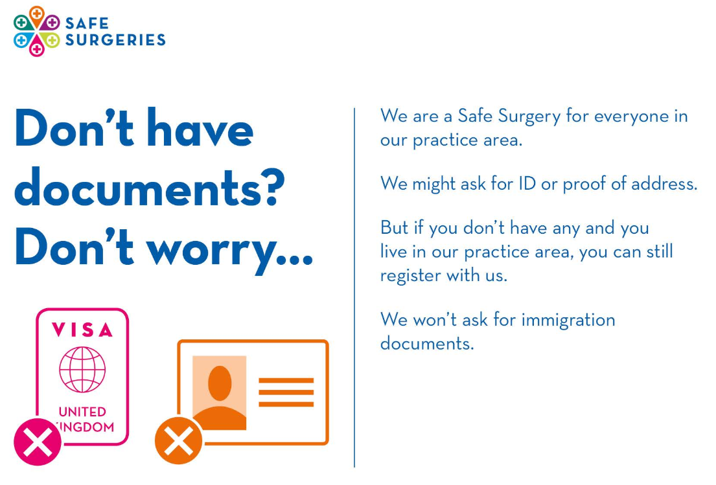
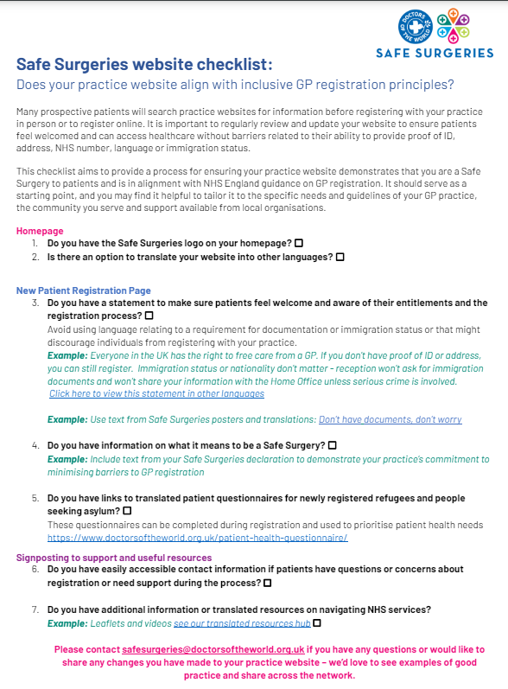
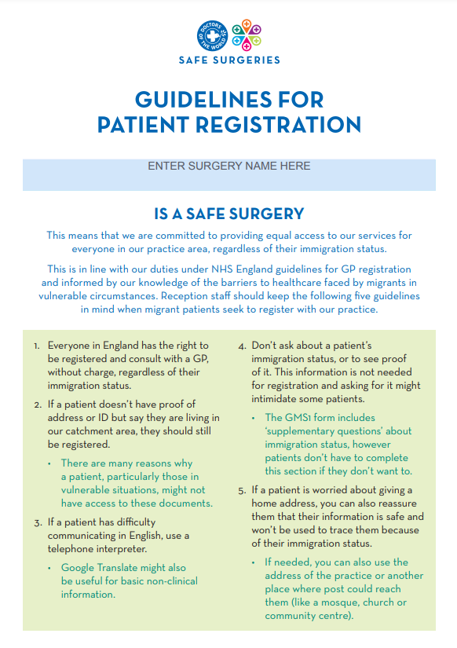
Inclusive registration processes
Sustainable change across your practice:
Include Safe Surgeries training in induction processes for new staff
Check your registration policy (see our template)
Display posters for staff and patients
Update your website (use our template and checklist)

Slide 28
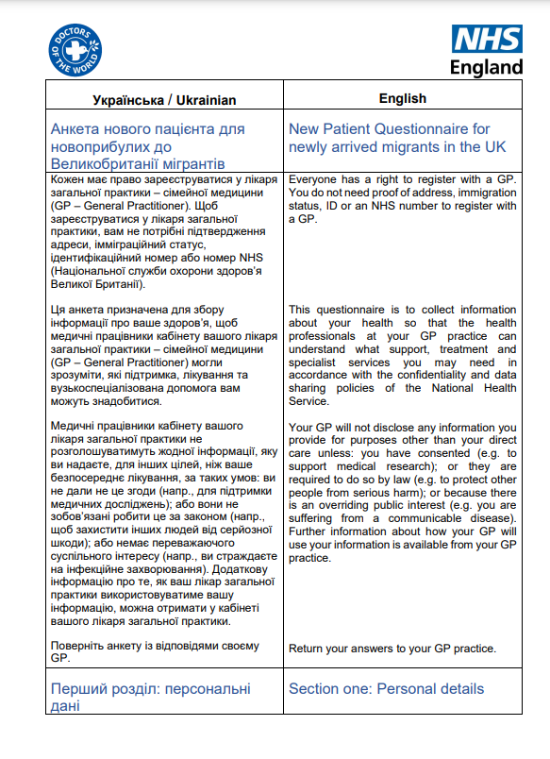
Patient health questionnaires
Translated patient health questionnaires for newly registered refugees and people seeking asylum
Multiple choice questions translated into 30 languages
Can be shared with patients at registration and discussed in initial health assessments/new patient checks
Two new SNOMED codes have been released to record that an Initial Health Assessment for newly arrived migrants has been undertaken, using the New Patient Questionnaire
https://www.doctorsoftheworld.org.uk/patient-health-questionnaire/
Notes:
New migrant health patient questionnaires available in over 20 languages (and English) to support with prioritisation of needs and access to information, particularly for those without previous health records - can be shared with patients during the registration process and they can return to the practice in first appointment/new patient check
Multiple choice questions so answers can be transferred without translation
Includes personal demographics, acute and chronic health needs including those associated with their pre-migration and migration experiences, medication and vaccination requirements, family history and lifestyle

Slide 29




Support beyond registration
Objectives
Appointment Booking
Administrative Support
Provide translation in all communication and pre-book interpreters
Flexibility - allow in-person appointment booking
Where possible, offer same day appointments and run drop-in clinics
Lower threshold for face-to-face appointments
Record communication/language needs in patient profile
Waive fees for medical reports and letters for people in vulnerable circumstances
Assist with access to online records with a flexible approach to identity verification or handheld records
Signposting
Translated resources
Display translated resources on how to register with a GP, navigating the NHS in different languages in the practice for patients, such as in waiting areas. See resources here.
Connect patients with a social prescriber (see our toolkit)
Provide a list of local support organisations in multiple languages

Slide 30
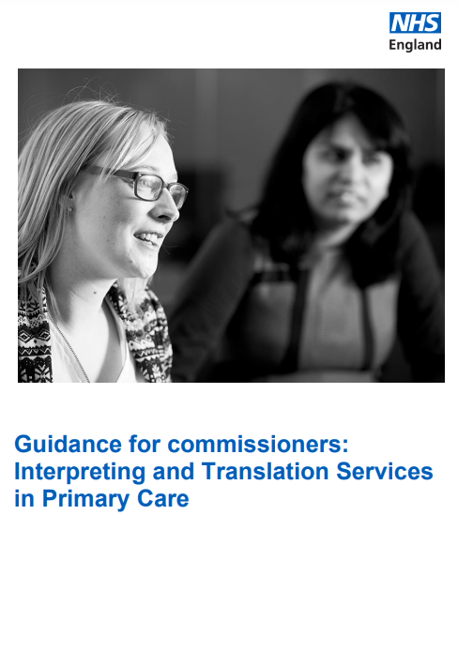

Language interpreting
Objectives
Be aware of local arrangements
Ensure availability of interpreters at reception and consultation
Double time for appointments
Record language and dialect in patient record + flag to pre-book (use a language identification chart)
Professional interpreters (avoid friends/family/children)
Raise awareness and promote the option to use an interpreter to patients
Handheld translators/tablets at reception
Patients should be able to access primary care services in a way that ensures their language and communication requirements do not prevent them receiving the same quality of healthcare as English speaking patients
Migrant Health guide - interpreting general principles
BMA guidance

Slide 31
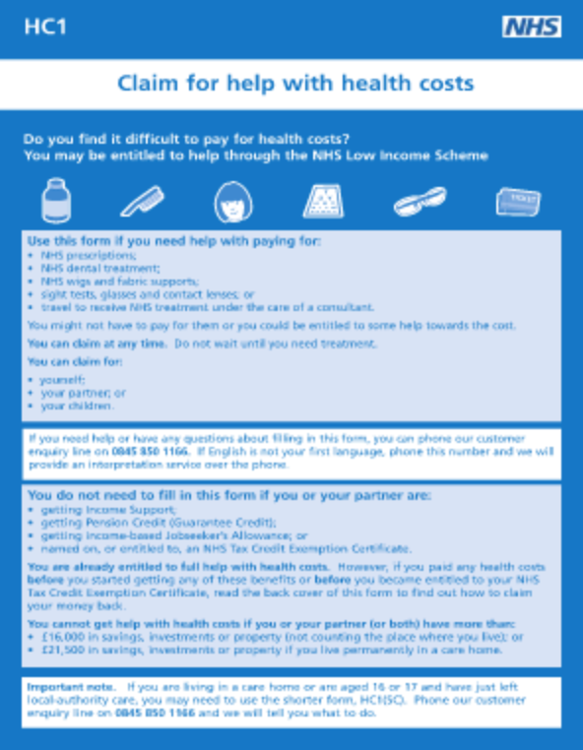
Help with health costs
Objectives
Anyone – regardless of immigration status – can apply for a HC2 certificate
Free NHS prescriptions, dental treatment and sight tests
Keep copies of the HC1 form in the reception area
Refer patients to organisations who can support completion of the HC1 form
Order HC1 forms in bulk from PCSE Online portal
Guidance for supporting application for people seeking asylum
Advice in other languages
https://www.nhsbsa.nhs.uk/nhs-low-income-scheme/hc2-certificates-full-help-health-costs

Slide 32
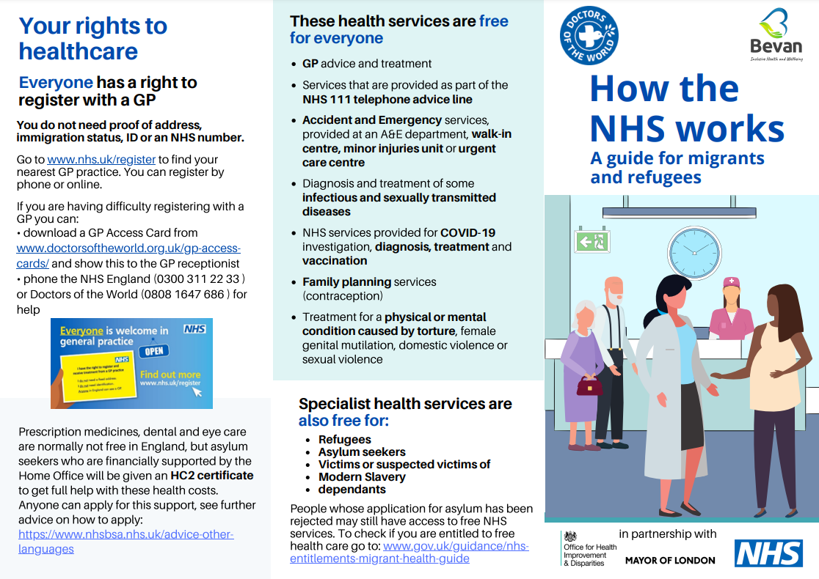
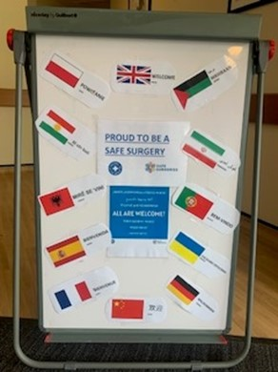
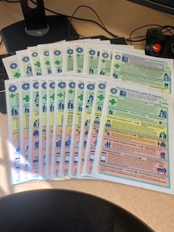
Translated resources
Objectives
DOTW Translated Resources
Navigating the NHS and Right to Health care
How to register with a GP
Right to hospital care
https://www.doctorsoftheworld.org.uk/translated-health-information/?_language=

Slide 33
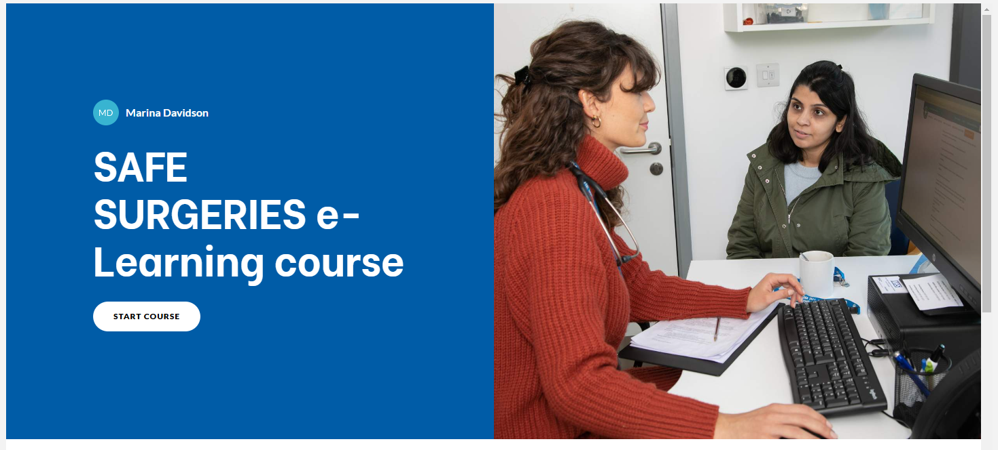
New e-Learning course
Share the course link with your colleagues.
Include the course in your induction for new staff.
Once completed, don’t forget to download your certificate add your certificate to your LinkedIn profile at the end
https://training.doctorsoftheworld.org.uk/catalog/info/id:131
Notes:
We have recently updated our e-Learning course on improving access to primary care and GP registration. This course is relevant for all staff across GP practices but will be particularly useful for frontline reception staff and practice managers. The course includes detail on how to become a Safe Surgery, a summary of NHS England guidance and useful resources to support patients.
You can access the free course here (registration required) and you will receive a certificate on completion of the course. It can also be included as part of the induction process for new staff.

Slide 34
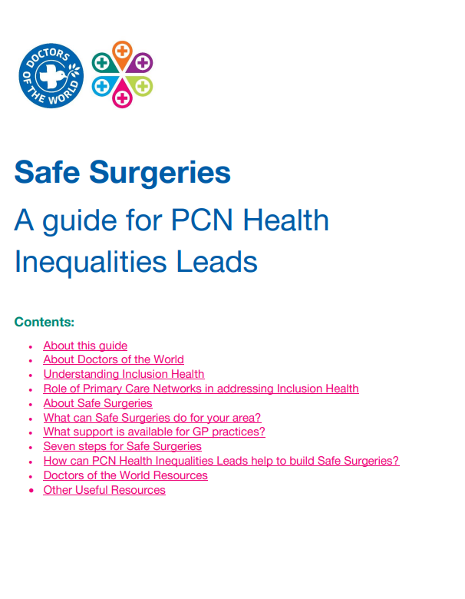
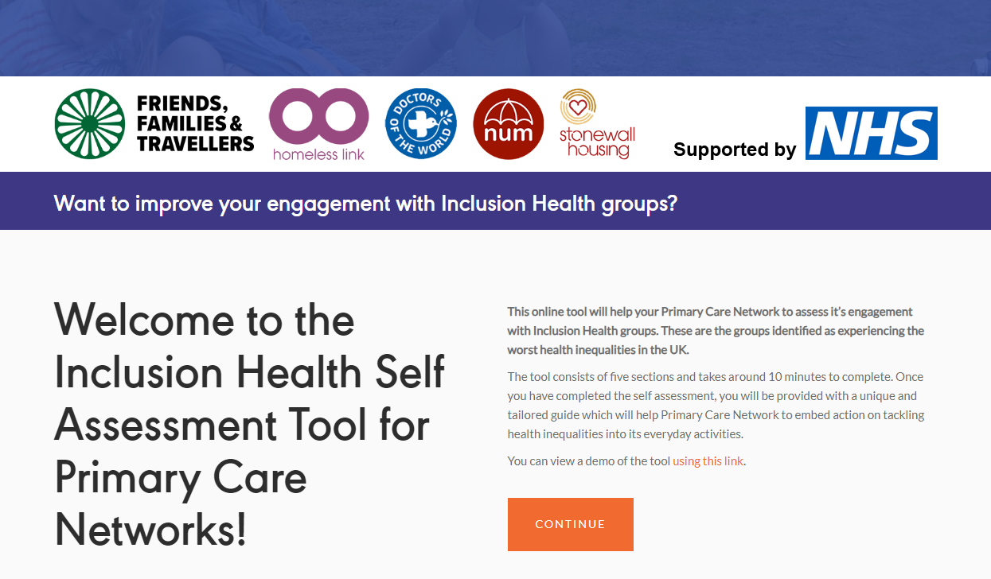
Engage with your PCN
PCNs have a critical role in addressing local health inequalities and improving access to care
PCN Health Inequalities Leads serve as a champion for this work and play an important role in identifying local inclusion health populations and supporting GP practices in their catchment area to better understand and meet the needs of these groups.
https://www.doctorsoftheworld.org.uk/wp-content/uploads/2023/07/DOTW-Safe-Surgeries-PCN-Health-Inequalities-Lead-Toolkit.pdf
https://www.inclusion-health.org/pcn

Slide 35
Next steps
What steps can you take to ensure all patients in your community can access healthcare?
Consider:
Individually
Practice wide

Slide 36
Secondary care charges
There are restrictions on some secondary care services depending on ordinary residence
Undocumented migrants are charged for some services – this includes some refused asylum seekers in England
Some services are always free or must not be withheld - “Urgent or immediately necessary” treatment to be provided regardless of ability to pay
Some groups are exempt
GP practices must ALWAYS refer patients to secondary care regardless of immigration status
4.4.2 Where a GP refers a patient for secondary services (hospital or other community services) they should do so on clinical grounds alone; eligibility for free care will be assessed by the receiving organisation.
4.4.3 The absence of any reciprocal arrangements between the nation-states, a patient’s nationality is therefore not relevant in giving people entitlement to register as NHS patients for primary medical services.
New guidance – updated September 2023
https://assets.publishing.service.gov.uk/government/uploads/system/uploads/attachment_data/file/1186860/nhs-cost-recovery-overseas-visitors_september2023.pdf

Slide 37
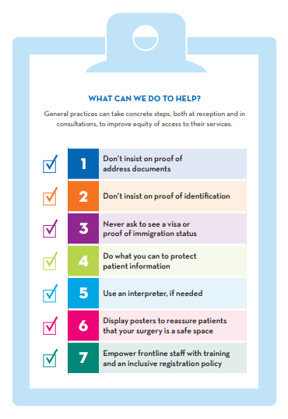
Next steps
Review the progress in your practice:
Have you returned your declaration? Step 1
Training across your practice?
Train your colleagues or share webinars
Display posters and check your website
Invite your PCN and other local practices to become Safe Surgeries
Let us know about your progress
Does your registration policy align with Safe Surgeries?

Slide 38
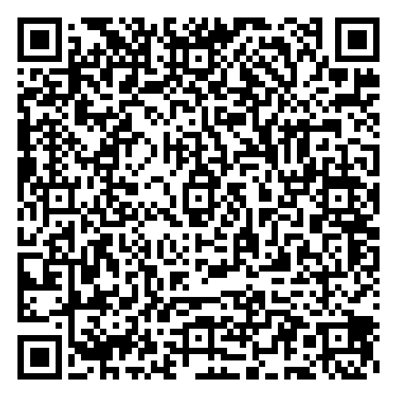
Join the community
Become a
Safe Surgery
and ensure that nobody in your community is excluded

Slide 39
Find out more https://www.doctorsoftheworld.org.uk/safesurgeries/
Feedback
Please complete our training evaluation form
Translated health information https://www.doctorsoftheworld.org.uk/translated-health-information/
Contact us safesurgeries@doctorsoftheworld.org.uk
DOTW clinic https://www.doctorsoftheworld.org.uk/patient-clinic/
Volunteer with us https://www.doctorsoftheworld.org.uk/jobs-and-volunteer-roles/
Stay connected

Slide 40
Resources
Primary care
Secondary care
Safe Surgeries guidance & resources.
NHS England guidance on GP Registration
BMA guidance on GP registration
BMA refugee and asylum seeker patient health toolkit
CQC guidance on refugees, asylum seekers, and other migrants
Migrant Health Guide
Inclusion Health Self Assessment Tool for PCNs
DH Guidance on implementing charging
Upfront charging framework and clinical case studies
Navigating NHS Charging in Secondary Care – DOTW
Supporting families facing NHS charging – flowchart
Improving access to maternity care

