Slide 1
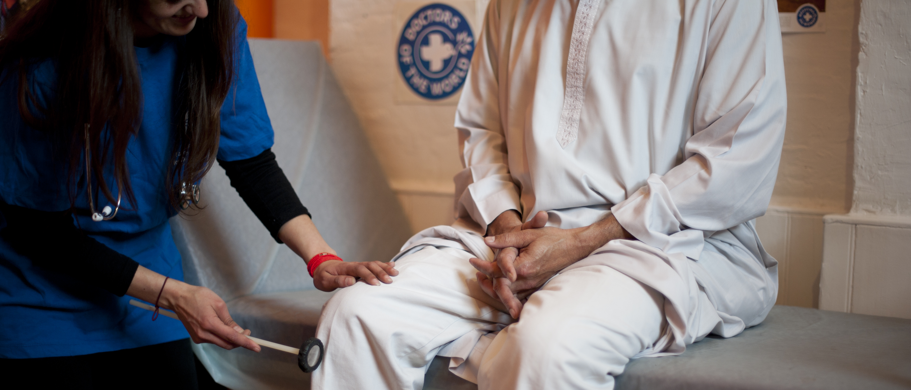

RIGHT TO HEALTHCARE
Improving access to healthcare for people in vulnerable circumstances
Doctors of the World UK, part of the Médecins du Monde network

Slide 2
Objectives
Discuss the importance of access to healthcare
Be aware of the barriers to healthcare access impacting underserved communities
Understand entitlements to NHS primary and secondary care in England
Know what good practice is to promote access to healthcare and support patients in vulnerable circumstances

Slide 3

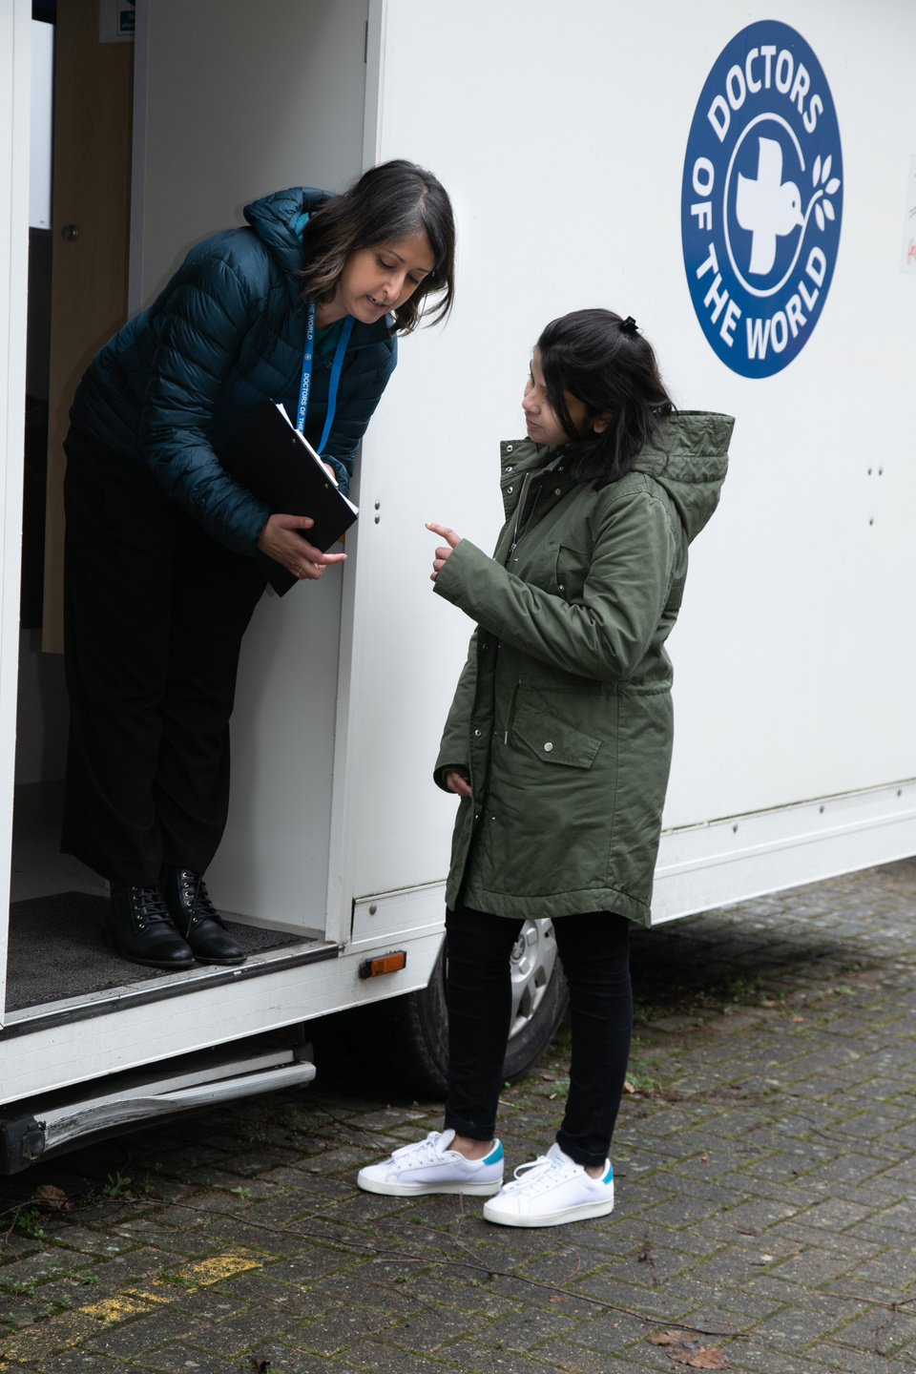
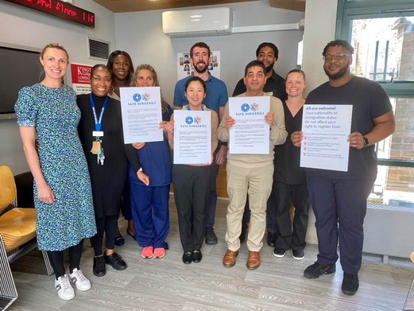
Our work in the UK
SUPPORTING GP PRACTICES
Safe Surgeries initiative: network of GP practices across the UK working to improve registration processes and reduce health inequalities
ADVOCATING FOR CHANGE
DIRECT SUPPORT TO INDIVIDUALS
Supported by our volunteer team of 35 Experts by Experience we aim to make systemic changes to how those currently excluded from healthcare can access health services
Our team of volunteer doctors, nurses and caseworkers provide medical advice and support to people in the UK who cannot access healthcare through our primary care clinic and advice line

Slide 4
Importance of GP registration
Safe discharge
Long-term follow up and continuity of care
Efficient use of services
Patients who face barriers to GP registration may attend A+E if issues become acute/not integrated into NHS services
Public health
Prevention and early detection of disease
Vaccination + screening programmes
Health equity
Cost effective
Promotes a fairer society
Financial + human cost of delayed access to care and preventative interventions
Core principle of the NHS is that it provides a ‘comprehensive service, available to all’
Human rights - UK is bound to give equal access to the right to health for all persons

Slide 5

Inclusion health
Inclusion health is a ‘catch-all’ term used to describe people who are socially excluded, typically experience multiple overlapping risk factors for poor health, experience stigma and discrimination, and are not consistently accounted for in electronic records
Inclusion Health groups are not a homogenous group and may be facing a wide variety of experiences
People from Inclusion Health groups are more likely to experience health inequalities and barriers to public services
Underserved groups face significant barriers in accessing healthcare
People with insecure immigration status
People experiencing homelessness
People from Gypsy, Roma and Traveller communities
People who sell sex
Survivors of modern day slavery
People who have experienced domestic violence
People recently released from prison
People with learning disabilities

Slide 6
Immigration status
Asylum seeker
A person who has left their country of origin and applied for asylum in another country but whose application has not yet been concluded.
Refused asylum seeker
A person whose asylum application has been unsuccessful
Refugee
Undocumented migrant
Someone who enters or stays in the UK without the documents required under immigration regulations.
Someone whose asylum application has been successful. The Government recognises they are unable to return to their country of origin owing to a well-founded fear of being persecuted

Slide 7
Immigration status
‘Undocumented’ migrants find themselves without the right documents for a variety of reasons, often beyond their control.
Survivors of trafficking
People who came to UK to work without a visa
People who came to the UK as children with undocumented parents
People whose visa has expired (student/ working)
Refused asylum seekers
People who don’t claim asylum due to lack of legal advice
People on spousal visas whose relationship breaks down
Domestic workers on expired visas which their employer doesn’t renew

Slide 8

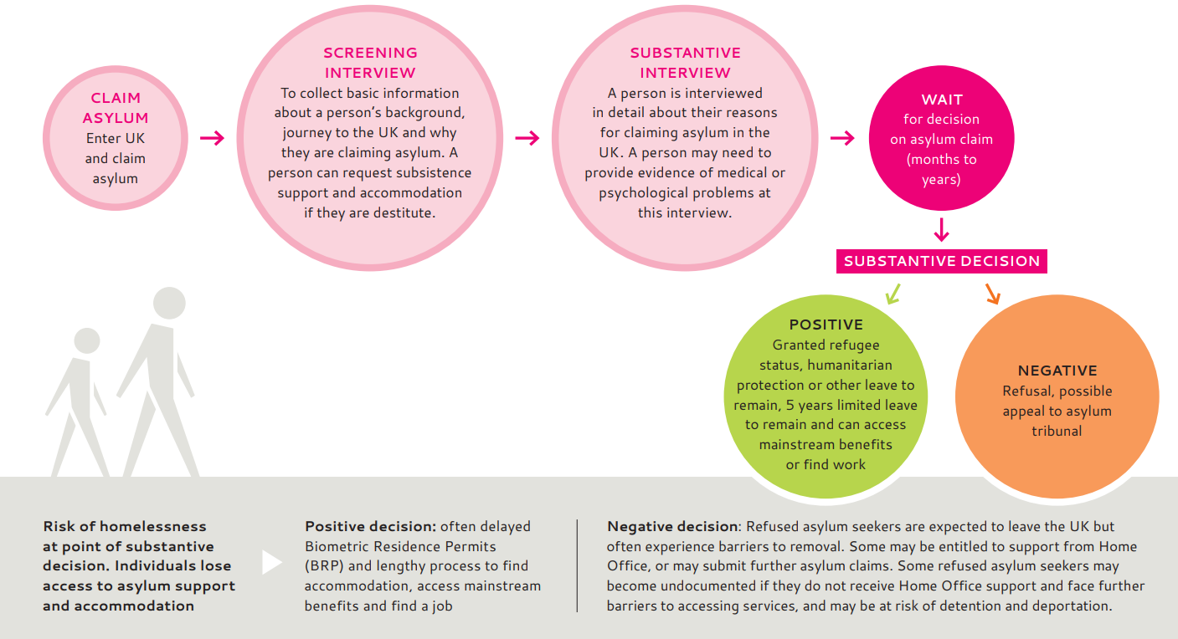
Asylum process
https://www.doctorsoftheworld.org.uk/wp-content/uploads/2025/06/clinician-toolkit-final.pdf

Slide 9
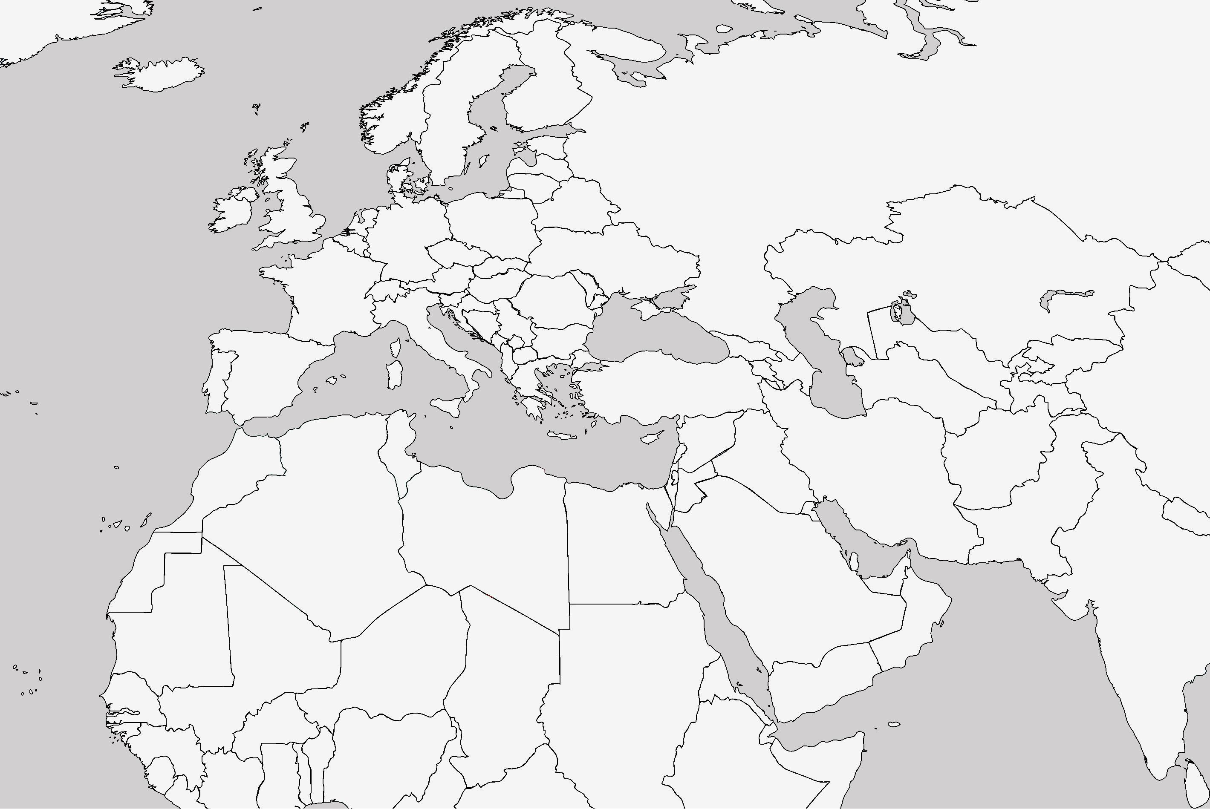
Barriers to accessing healthcare
Street homeless in London, after 2 months taken to a church by a lady she met on the street.
Smuggled to “the Jungle” in Calais and then to London
Imprisoned in Libya; became a street homeless and a victim of sexual assault in Italy.
Miriam (28) fled Eritrea after escaping conscription into national military service.
Notes:
Miriam is a 28 year old lady who fled Eritrea after escaping conscription into national military service. She had been abused, raped and denied medical treatment. She travelled through Sudan, to Libya and then on to Italy.
She was imprisoned in Libya, street homeless in Italy and raped by a group of young men. She was smuggled to ‘the Jungle’ in Calais; by this point her mental health was deteriorating: ‘At that moment I was having a lot of stress…maybe I was screaming, things like that’
She was smuggled into the UK. She was street homeless in London and then after 2 months was taken to a church by a lady she met on the street. “I started to beg her, my feet were swollen and I had been walking up and down for 2 days. I hadn’t showered and I hadn’t eaten well. She could see that I was pregnant”. She was allowed to sleep in the church. Members of the congregation bring her food, and sometimes they let her stay with them.

Slide 10
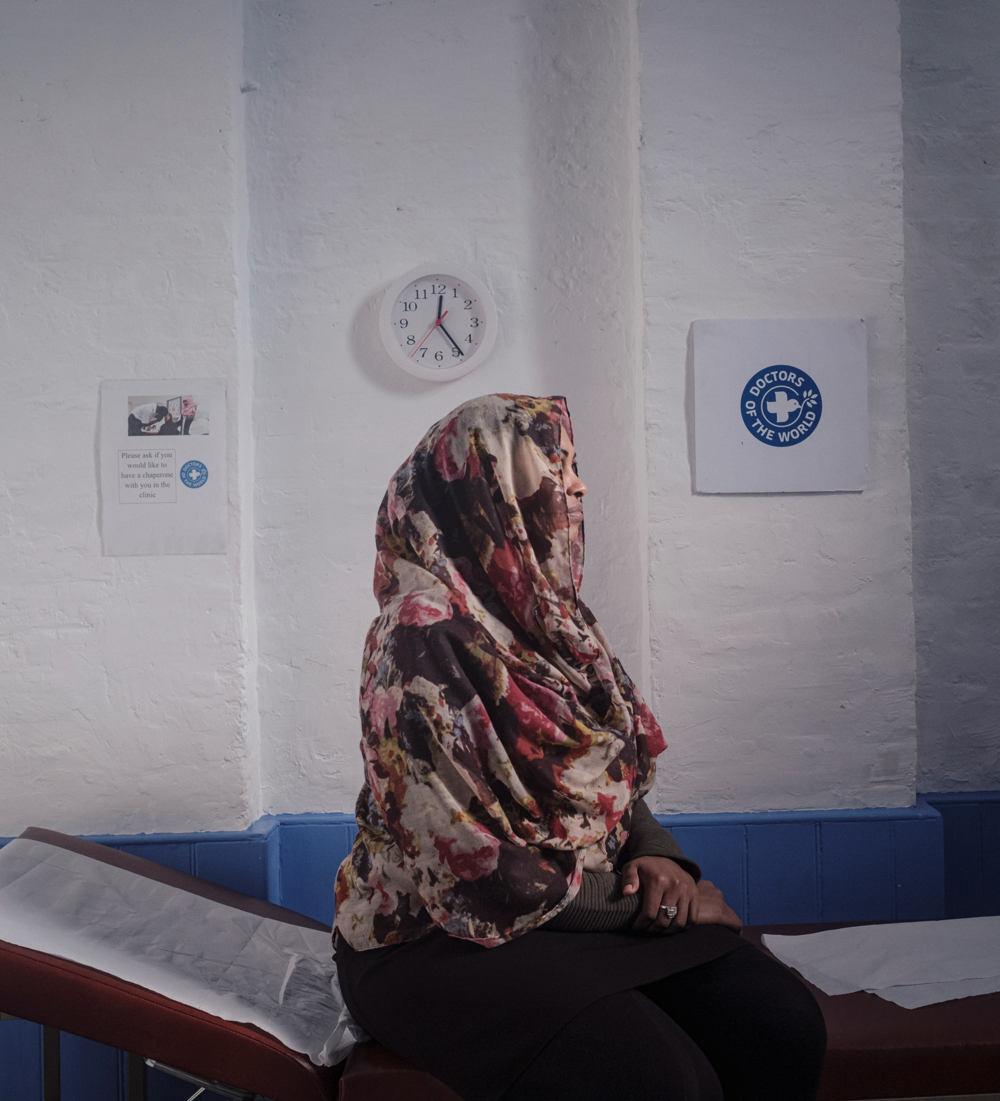

Barriers to accessing healthcare
Miriam was turned away from registering with a GP practice 3 times
She was 29 weeks pregnant before first antenatal appointment
She came to DoTW clinic and was supported to register with a GP in the area where she was staying
What were the barriers Miriam likely faced in registering with a GP?
How could you support Miriam in the practice?

Slide 11
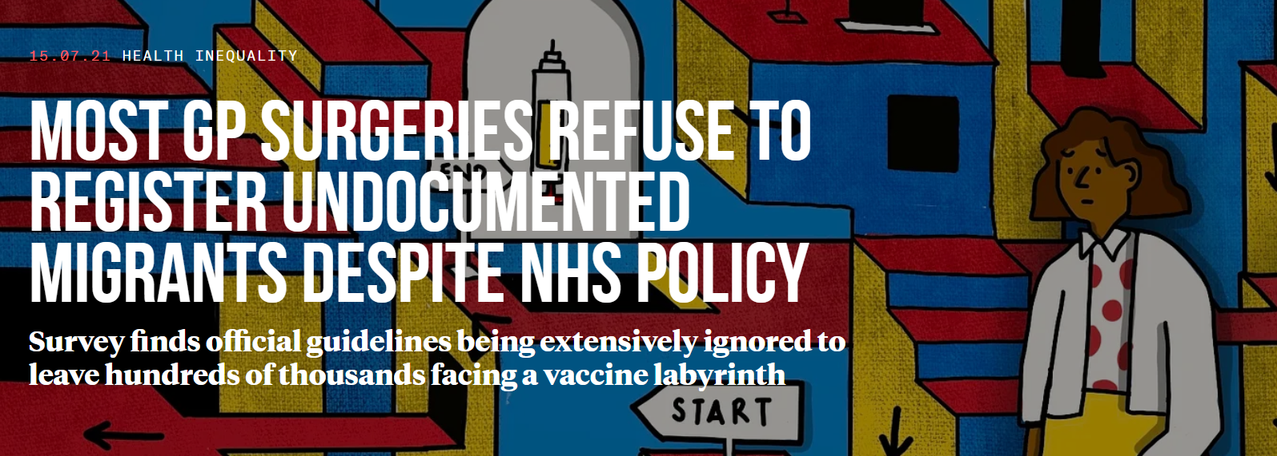


The Bureau contacted around 1/3 of GP practices in 10 locations across the UK. They asked about registering a hypothetical patient: “Rosa”, a woman in her 40s without ID or proof of address:
62% said they would not register the patient
14% were unsure
Only 24% of GP surgeries surveyed in the UK would register someone without proof of address, ID or legal immigration status
https://www.thebureauinvestigates.com/stories/2021-07-15/most-gp-surgeries-refuse-to-register-undocumented-migrants

Slide 12









Barriers to accessing healthcare
Accessibility: language, literacy, digital, telephone
Lack of knowledge on navigating the NHS/entitlement
Immigration status checks, fear of data sharing and Home Office reporting
Lack of ID or proof of address
Fear /experience of judgement and prejudice
Lack of funds for suitable transport to attend appointments

Slide 13


Barriers to accessing healthcare
Proof of ID or address?
People who are undocumented
Survivors of trafficking or modern slavery
Children born in the UK to parents without documentation
People who cannot afford to renew documents e.g. passport
People fleeing domestic abuse staying with friends, family or in a shelter
People working in exploitative situations whose’ employer has taken their documents
People seeking asylum and refugees who have lost documents during their journey to the UK
People who have submitted documents to the Home Office for application
People living on a boat
People with no fixed address (unstable accommodation, sofa-surfing, street homeless
Young people leaving care

Slide 14
NHS England guidance
Practices should ensure there is equitable access for all patients who wish to register with them
Anyone in England can register and consult with a GP without charge
Nationality & immigration status are not relevant to GP registration
There is no requirement for proof of ID, address or NHS number to register
Patients without a fixed address can register using the practice address (or alternative address)
If there is uncertainty on the length of time a patient is in the area e.g. asylum seekers in Home Office accommodation -> permanent patient registration
https://www.england.nhs.uk/publication/primary-medical-care-policy-and-guidance-manual-pgm/
Notes:
Practices should ensure there is equitable access for all patients who wish to register with them. Registration should be available to all patients every day during opening hours. Patients should be able to register via a paper form (new PRF1 form) or online and this should be made clear
(The GMS1 form is being phased out and will not be available to order from the PCSE website from 31 October 2024)
Anyone in England may register and consult with a GP without charge.
This includes all asylum seekers and refugees, overseas visitors, students, people on work visas and those who are homeless, whether lawfully in the UK or not, are eligible to register with a GP practice.
A patient does not need to be ‘ordinarily resident’ in England to be eligible for NHS primary medical care (this only applies for secondary care).
There is no regulatory requirement to prove identity, address, immigration status or the provision of an NHS number in order to register
Lack of proof of address/ID “would not be considered reasonable grounds to refuse to register a patient” or withhold appointments.
An alternative address can be used for people with no fixed address or who are afraid to share their address.
This is a "care of" address which can be the practice address or another address such as a place of worship or community centre, or an address which the local authority has provided to the patient to use.
Practices should try to ensure they have a way of contacting the patient if they need to (for example with test results)
There are very limited circumstances in which registration can be refused: if a practice is not taking on new patients (agreed with commissioners), only accepting patients in the practice boundary, or other exceptional circumstances Any registration refusals should be recorded, communicated to patients and made available to commissioners on request.
In some cases a prospective patient may not know how long they will reside in an area. People seeking asylum housed in Home Office commissioned “initial” accommodation may be accommodated in these settings for extended periods of time.
“…where there is uncertainty over the length of time that a patient may be residing in an area, but this is likely to be months rather than weeks, NHS England advises that the patient should be registered as a permanent patient.”
This is important for continuity of care, ongoing medical records and to generate an NHS number if patients do not have one already.

Slide 15
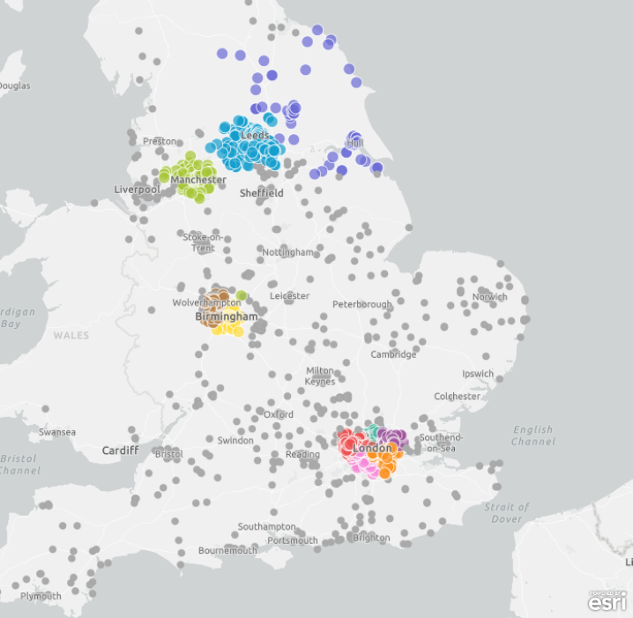
What can be done?
Building an expert community against health exclusion
A network of GP practices demonstrating adherence to NHS England guidance and making commitments to tackle barriers to healthcare faced by underserved communities
Launched by DOTW in 2018, in partnership with primary care - recognising pressures and increasing workloads facing GP practices
Free training, resources and support
2,500+ Safe Surgeries across the UK…

Slide 16
Why become a Safe Surgery?
Comply with NHS policy
Be part of a supportive national network
CQC approved
Improve efficiency and communication in the registration process
Improve patient experience
Meet the needs of your community
Support staff learning and skills building
Share good practice
Ensure lack of documents, immigration status and language do not prevent registration
CQC Equity in Access Framework
We make sure that everyone can access the care, support and treatment they need when they need it. People can access care, treatment and support when they need to and in a way that works for them, which promotes equality, removes barriers or delays and protects their rights.'

Slide 17

Safe Surgeries process
First, register as a Safe Surgery (sign up form here), then complete 5 steps:
1. Sign the Safe Surgeries declaration + nominate practice lead
2. Complete Safe Surgeries training and review resources
3. Review practice registration policy
5. Engage with the Safe Surgeries network and update DOTW
4. Display posters in practice and update website

Slide 18
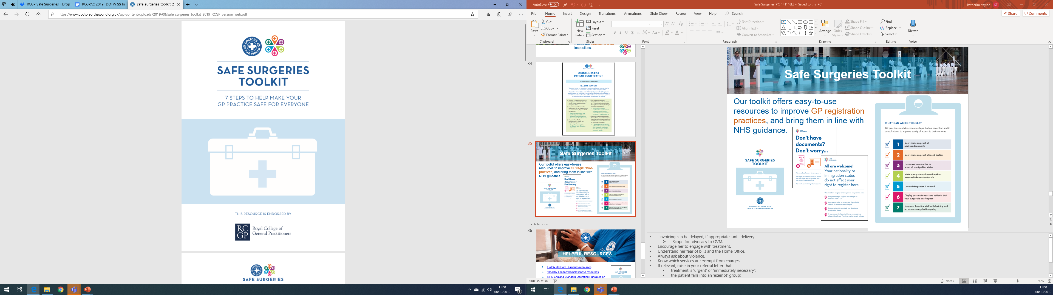
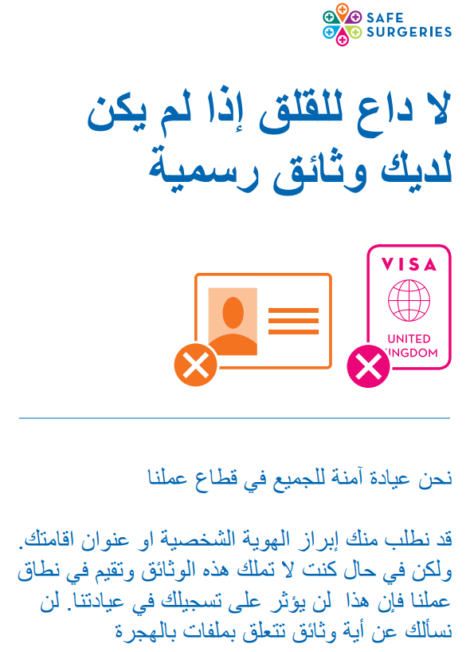
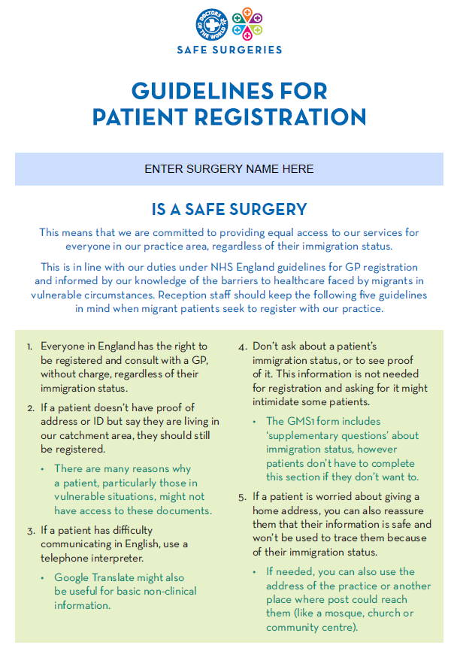

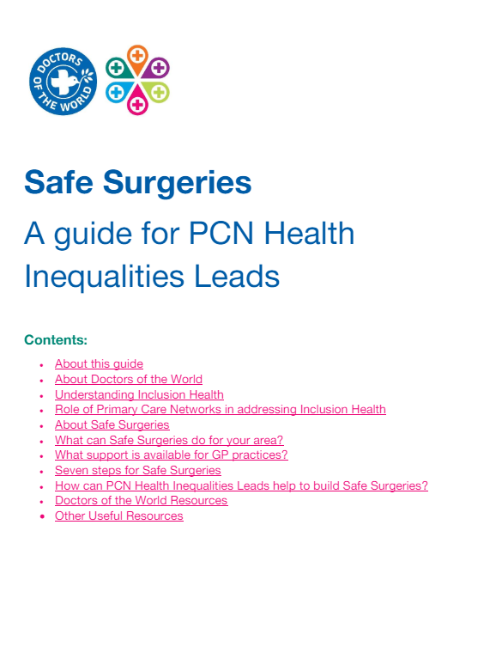
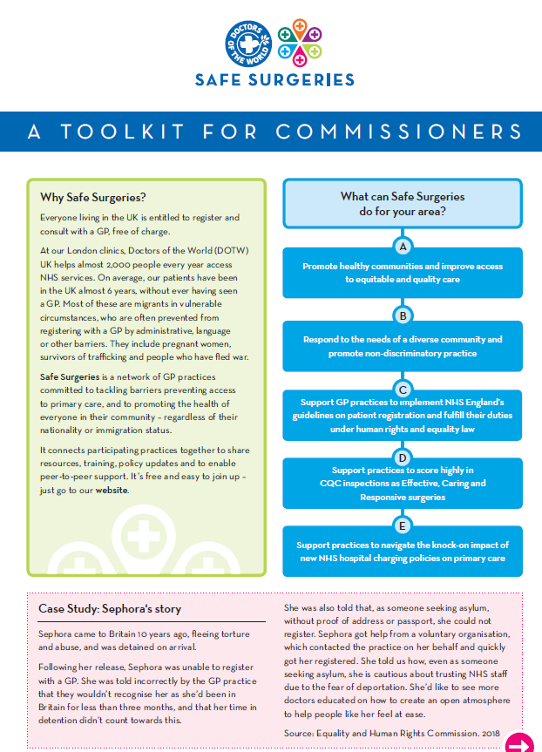
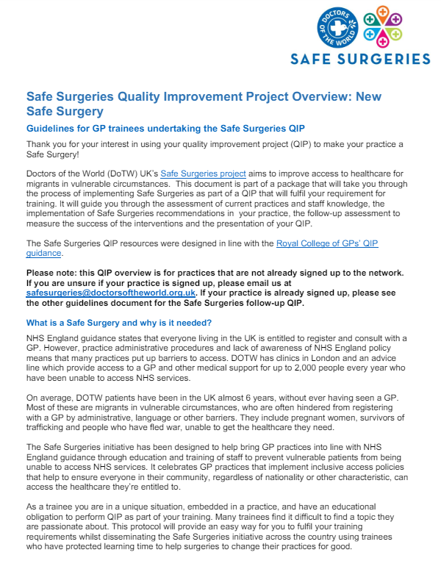
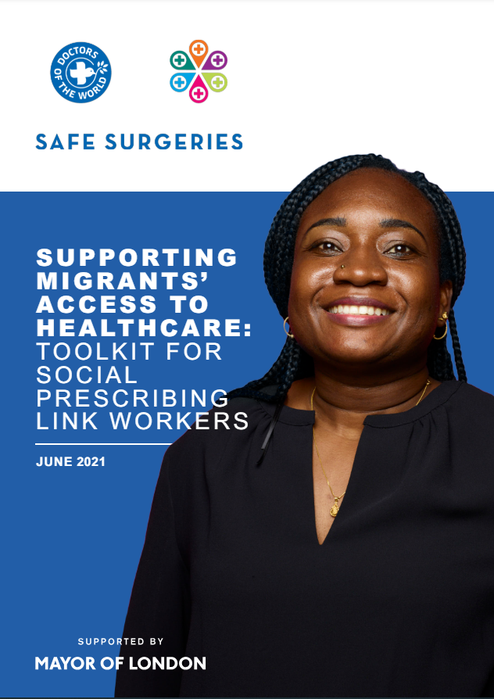
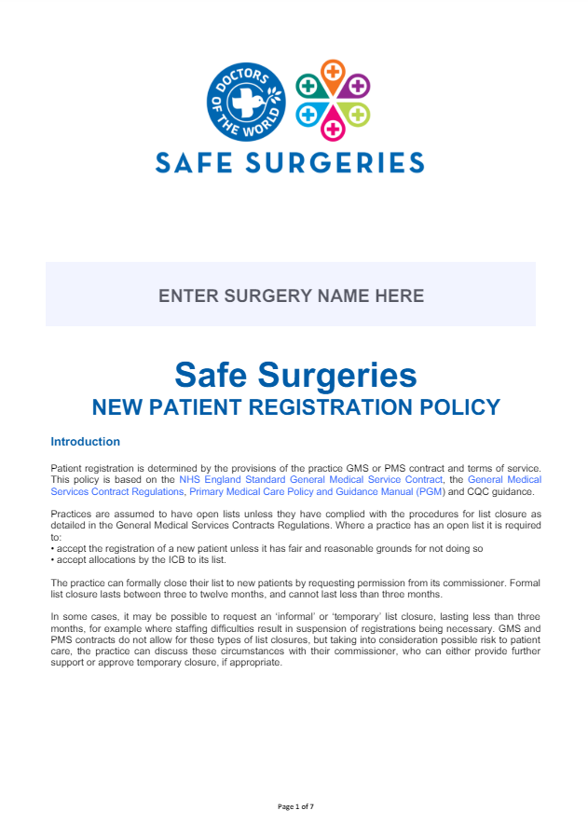
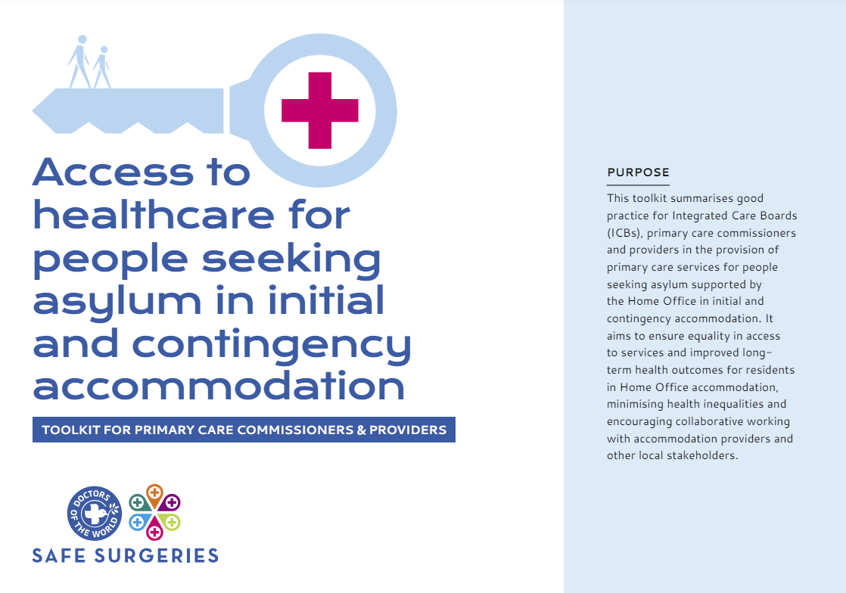
Safe Surgeries resources
https://www.doctorsoftheworld.org.uk/safesurgeries/safe-surgeries-toolkit/

Slide 19
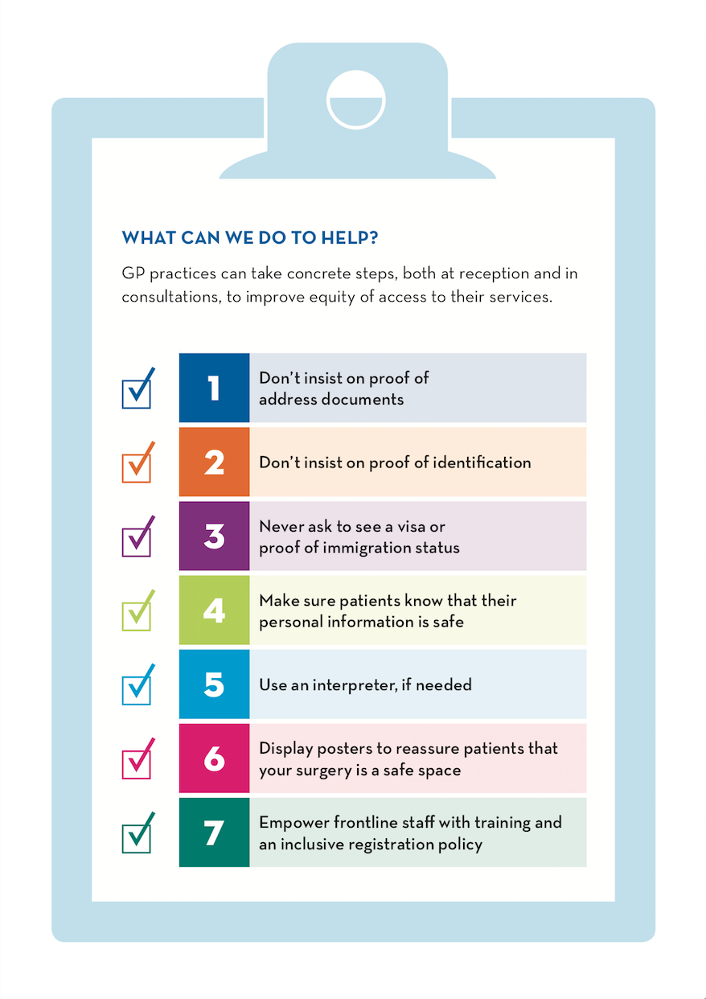

7 steps for safe registration
https://www.doctorsoftheworld.org.uk/safesurgeries/safe-surgeries-toolkit/

Slide 20
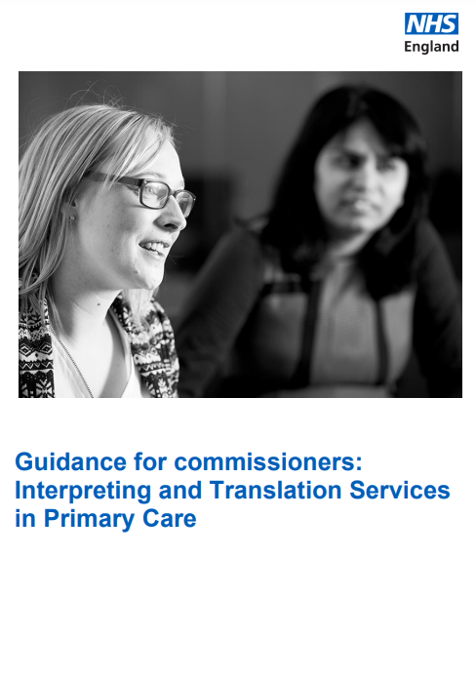

Language interpreting
Objectives
Be aware of local arrangements
Ensure availability of interpreters at reception and consultation
Double time for appointments
Record language and dialect in patient record + flag to pre-book (use a language identification chart)
Professional interpreters (avoid friends/family/children)
Raise awareness and promote the option to use an interpreter to patients
Handheld translators/tablets at reception
Patients should be able to access primary care services in a way that ensures their language and communication requirements do not prevent them receiving the same quality of healthcare as English speaking patients
Migrant Health guide - interpreting general principles
BMA guidance

Slide 21
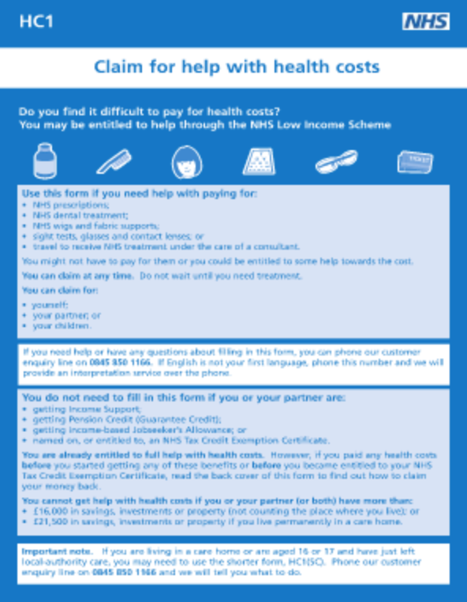
Help with health costs
Objectives
Anyone – regardless of immigration status – can apply for a HC2 certificate
Free NHS prescriptions, dental treatment and sight tests
Keep copies of the HC1 form in the reception area
Refer patients to organisations who can support completion of the HC1 form
Order HC1 forms in bulk from PCSE Online portal
Guidance for supporting application for people seeking asylum
Advice in other languages
https://www.nhsbsa.nhs.uk/nhs-low-income-scheme/hc2-certificates-full-help-health-costs

Slide 22
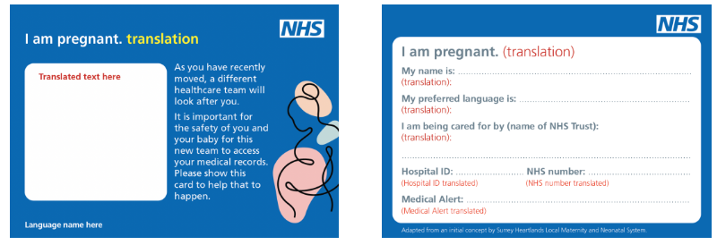
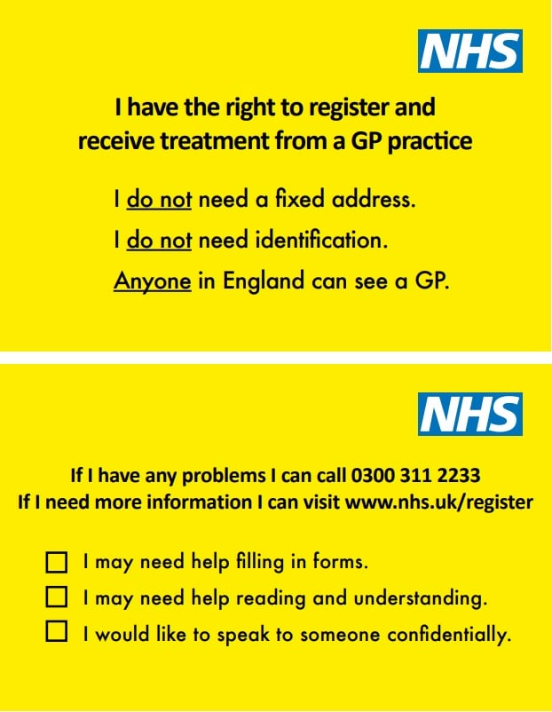
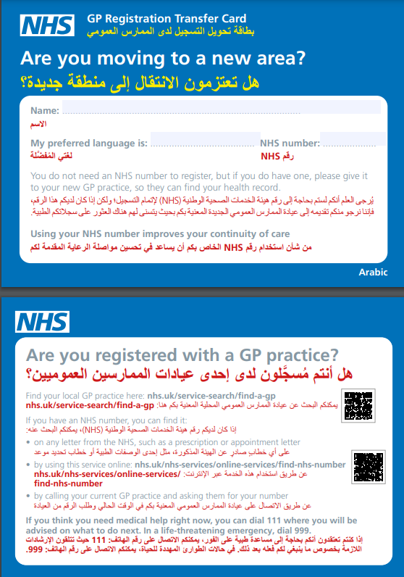
Advocacy cards

Slide 23
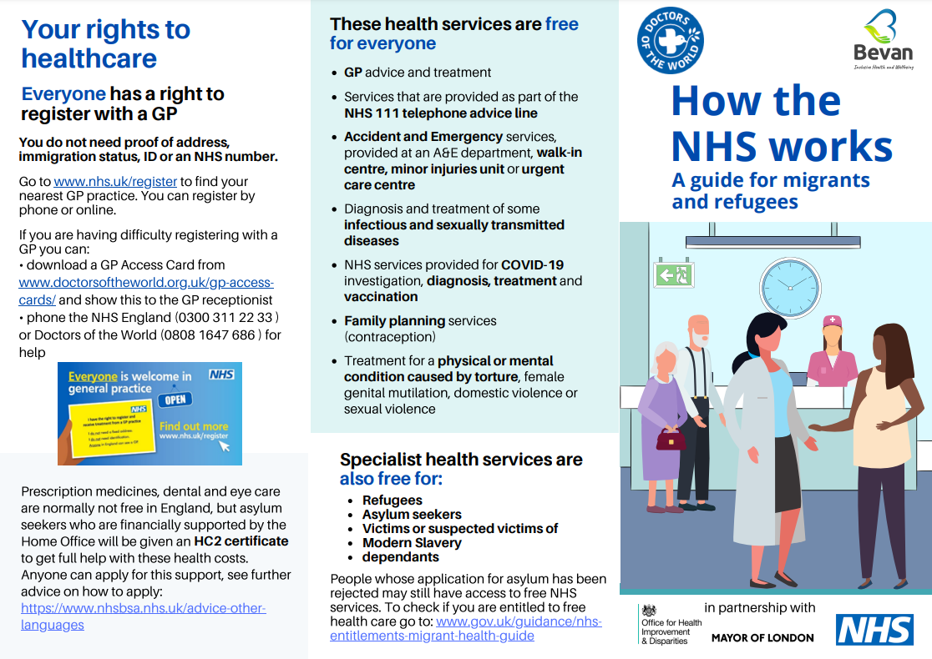
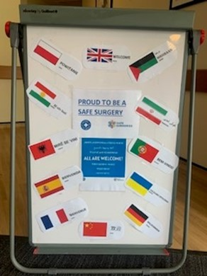
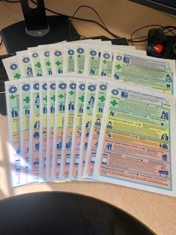
Translated resources
Objectives
DOTW Translated Resources
Navigating the NHS and Right to Health care
How to register with a GP
Right to hospital care
https://www.doctorsoftheworld.org.uk/translated-health-information/?_language=

Slide 24
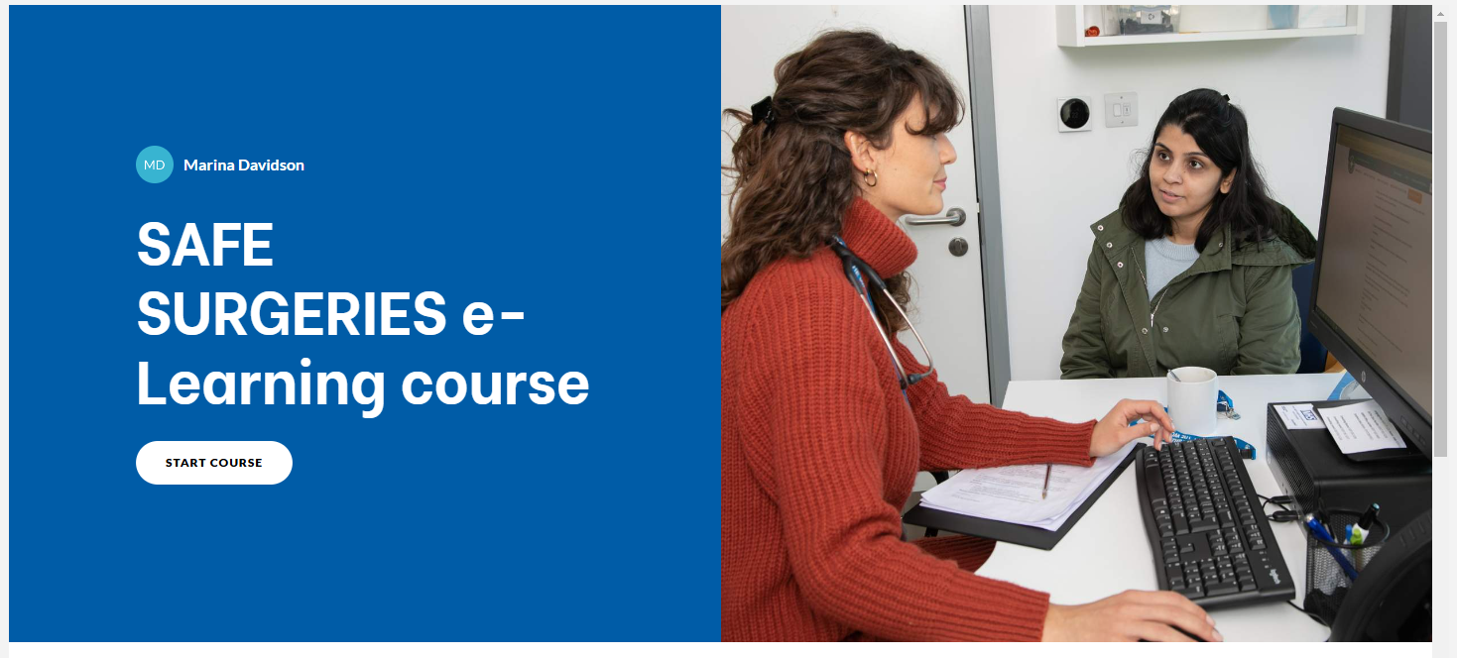
New e-Learning course
Share the course link with your colleagues.
Include the course in your induction for new staff.
Once completed, don’t forget to download your certificate add your certificate to your LinkedIn profile at the end
https://training.doctorsoftheworld.org.uk/catalog/info/id:131

Slide 25
Secondary care charges
There are restrictions on some secondary care services depending on ordinary residence
Undocumented migrants are charged for some services – this includes some refused asylum seekers in England
Some services are always free or must not be withheld - “Urgent or immediately necessary” treatment to be provided regardless of ability to pay
Some groups are exempt
GP practices must ALWAYS refer patients to secondary care regardless of immigration status
4.4.2 Where a GP refers a patient for secondary services (hospital or other community services) they should do so on clinical grounds alone; eligibility for free care will be assessed by the receiving organisation.
4.4.3 The absence of any reciprocal arrangements between the nation-states, a patient’s nationality is therefore not relevant in giving people entitlement to register as NHS patients for primary medical services.
New guidance – updated September 2023
https://assets.publishing.service.gov.uk/government/uploads/system/uploads/attachment_data/file/1186860/nhs-cost-recovery-overseas-visitors_september2023.pdf

Slide 26
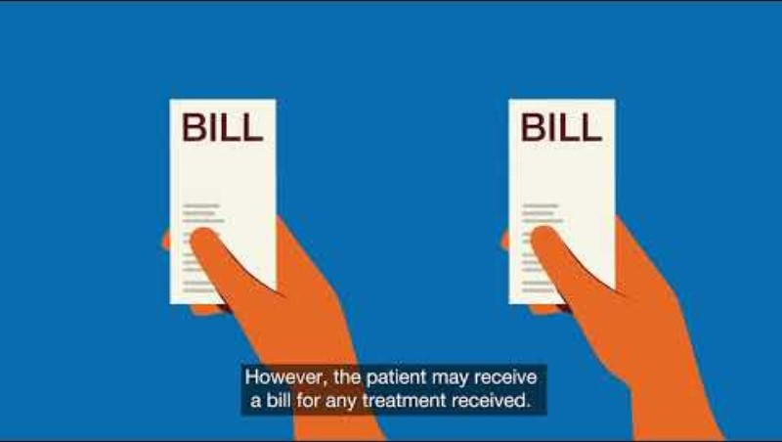

Secondary care charges
https://www.youtube.com/watch?time_continue=14&v=XrqKyH7x4Mg&feature=emb_logo

Slide 27
Ordinary residence
Patients can access free secondary care if they are ordinarily resident (or above exemptions apply)
Residing lawfully and voluntarily in the UK for settled purposes
Case-by-case basis
Anyone who is subject to immigration control cannot be ordinarily resident unless they have Indefinite Leave to Remain, or pre-settled or settled status (EUSS)
An overseas visitor is defined in the Charging Regulations as anyone who is not ordinarily resident in the UK
https://assets.publishing.service.gov.uk/media/60a66068e90e071b566c1f5b/ordinary-residence-tool.pdf

Slide 28
Exempt groups
Refugees and asylum seekers
Some refused asylum seekers
Victims or suspected victims of modern slavery
Children looked after by a local authority
People in prison + immigration detention
People treated under the mental health act
People who have paid the Immigration Health Surcharge
People covered by reciprocal healthcare agreements
Notes:
Refugees – asylum, humanitarian protection and temporary protection including appeals not determined
Refused asylum seekers are exempt in Scotland and Wales
Refused asylum seekers receiving “section 4” support (those destitute and prevented from returning to country of origin), section 21 local authority support, or support under section 1 of Care Act
Victims or suspected victims of modern slavery determined by the Home Office/Human Trafficking Centre (and their dependents) – more on this later
Section 4 support - refused asylum seekers making arrangements for a voluntary departure or there is another temporary barrier to leaving the UK
Children under 18 are not automatically exempt – the person with parental responsibility is liable for the charge
If the person is coming to the UK on a temporary stay of more than 6 months may be required to pay an immigration health surcharge at the time of your visa application.
£1,035 from £600 (recent increase for the Immigration Health Surcharge)

Slide 29
Exempt services
Accident and emergency services
Diagnosis of some communicable disease (e.g. HIV, TB)
Screening, diagnosis and treatment of sexually transmitted infections
Family planning services
Services provided to treat physical or mental illness caused by sexual or domestic violence, FGM, or torture
Services provided by GPs, school nurses and health visitors
NHS 111
Palliative care provided by a registered palliative care charity
Notes:
Accident and emergency services (A&E, walk in clinics, urgent care, minor injuries, amblulance services) prior to admission, including investigations
A&E – It does not include those emergency services provided after the overseas visitor has been accepted as an inpatient or at a follow-up outpatient appointment.
This applies irrespective of where the violence took place, provided that a patient had not travelled to the UK solely to obtain treatment
Diagnosis of some communicable disease (e.g. HIV, TB) – routine screening and vaccinations but not treatment of secondary illnesses associated with infection
Screening, diagnosis and treatment of sexually transmitted infections
Family planning services (contraception and advice, not ToP)
Services provided to treat physical or mental illness caused by sexual or domestic violence, FGM, or torture only for treatment related to experience of violence
Services provided by GPs, school nurses and health visitors
NHS 111
Palliative care provided by a registered palliative care charity (chargeable from relevant NHS body)
Community mental health services are chargeable, community nursing and physio
Health visitor and school nursing are exempt
Investigations instituted by GPs – Blood tests where results go back to GP are free but X-rays (which are reported by sec care radiologists), scans, ecgs and anything else that is reported on by secondary care is charged for

Slide 30
Urgent or immediately necessary?
Urgent and immediately necessary care must be given regardless of ability to pay but patient will be charged after receiving care
Decision made by treating clinician (not OVM)
Care should not be withheld until the clinician confirms that it is non-urgent care (see Clinical patient assessment form).
Diagnostics required to establish whether a service is “Urgent” or “immediately necessary” should not be withheld (although are chargeable)
Notes:
It is the responsibility of the doctor alone to decide the urgency of a patient’s needs through initial assessments of a patient’s symptoms and other factors, and further investigations required to make a diagnosis.
The assessments and investigations will be included by administrative staff in any charges made but they cannot be withheld even if a payment for treatment has not been received upfront for the cost of the assessment

Slide 31






Urgent or immediately necessary?
“Care that cannot wait until the person leaves the UK. Should take into account pain, disability, and the risk of the delay exacerbating their condition.”
Takes into account the date that patient is ‘reasonably expected to leave the UK’, established by OVM – accurate return date essential and can be challenged
“Life saving, will prevent a condition becoming life-threatening or will prevent permanent serious damage.”
Maternity services are always “immediately necessary”.
Everything else is based on the treating clinician's decision
Refused asylum seekers and undocumented migrants often face many obstacles to leaving the UK - assume may not be able to return within 6 months
Example: Undocumented migrant unlikely to leave the UK in the next year with a non-melanoma skin cancer – treatment (cryotherapy) is urgent
Example: Acute renal disease requiring 3x dialysis a week
As treatment is immediately necessary the date on which the patient can reasonably be expected to return home is irrelevant
Immediately necessary
Urgent

Slide 32
Urgent or immediately necessary?
Clinician makes assessment if care is “urgent” or if it can wait
“If the person is unlikely to leave the UK for some time treatment which clinicians might otherwise consider non-urgent is more likely to be considered by them as urgent” (Department of Health guidance)
How to decide if treatment is urgent?
Pain or disability the condition is causing
The risk that delay might require more expensive or involved interventions
The likelihood of a substantial or life-threatening deterioration if treatment is delayed until return to home country

Slide 33
Non-urgent care
If none of the exemptions apply, and the clinician decides the treatment is not urgent or immediately necessary -> non-urgent
Costs recovered up-front
If patients do not pay, treatment will not be provided
Patients can present again for reassessment if their condition changes or return date passes
150% of cost to the NHS

Slide 34
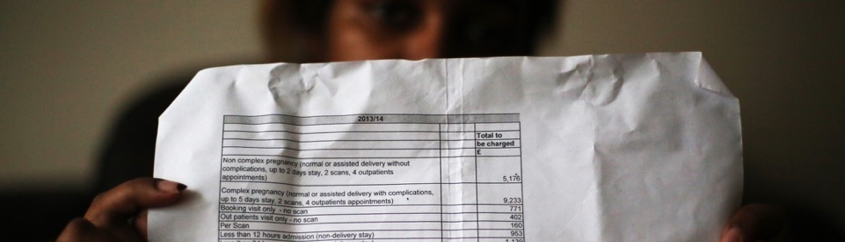
Charging as a barrier to healthcare
Fear makes people avoid healthcare
Exemptions to public health do not work: screening or vaccinations missed (not registered with GP)
Bills and debt collection (people driven into exploitative work to pay bills)
Debts reported to the Home Office and affects future immigration applications and right to travel
Confusion about the rules and poor practice
Incorrect billing
Immediately necessary or urgent treatment often delayed or denied
Patients billed for services that should be exempt e.g. asylum seekers or refugees

Slide 35
Refer to DOTW
If your patient is refused treatment:
Refer to DOTW’s casework team
Doctors of the World’s advice line on freephone 0808 1647 686
If you’re calling from an organisation, please call our clinic office line: 0207 0789 629 or email clinic@doctorsoftheworld.org.uk
More information here
How we can support:
Advocate for those denied secondary care
Advice for individuals and their families to navigate a complex system
Write to OVMs and debt management companies for destitute people; proactively requesting manageable repayment plans
Signpost to debt advice, immigration advice and other support.
Explain the implications of not engaging with NHS debt
Report on the harm caused by NHS charging

Slide 36
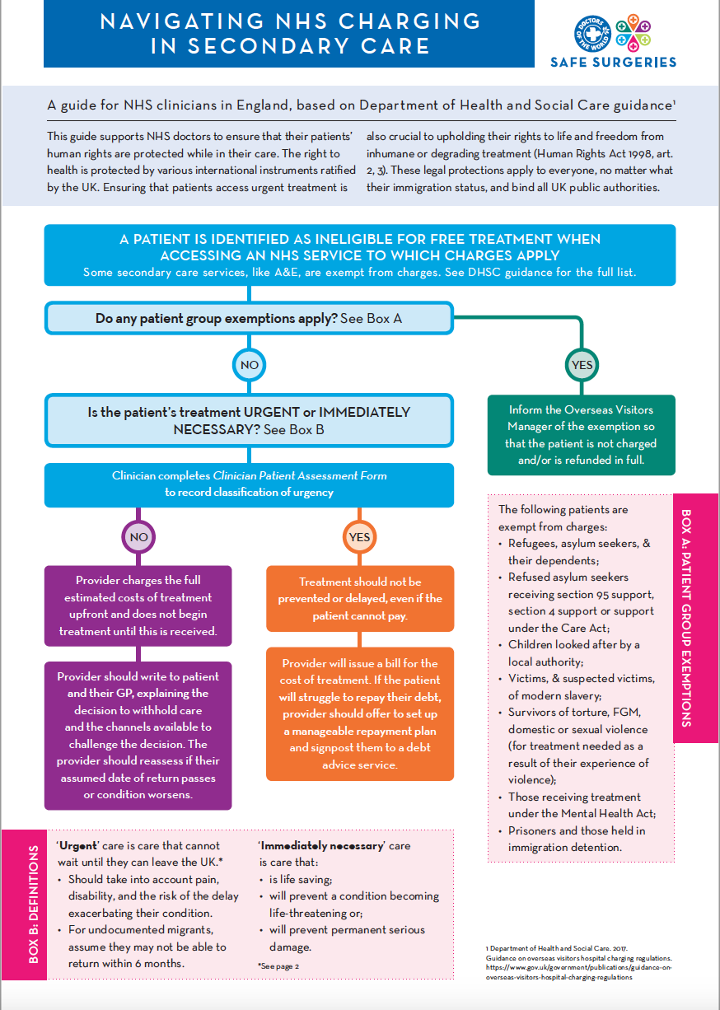
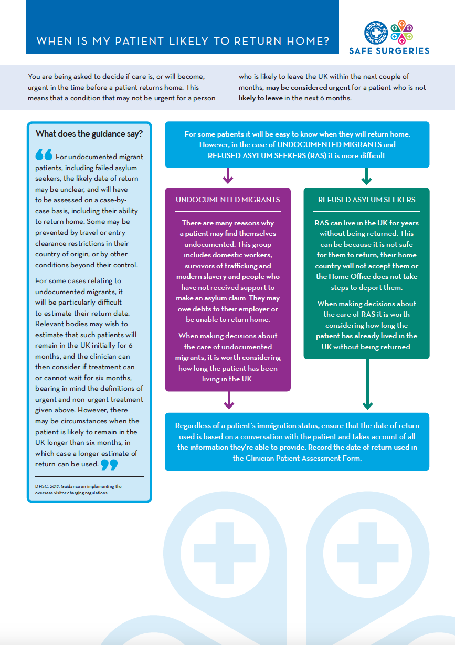
Navigating NHS charging
https://www.doctorsoftheworld.org.uk/wp-content/uploads/2019/05/urgent_care_guidelines.pdf

Slide 37
Impact of NHS charging
Case Study: Miriam
At the hospital the Overseas Visitors Manager identifies Miriam as an undocumented migrant.
She is sent an invoice for her ANC.
Is the Overseas Visitors Manager correct?

Slide 38
Impact of NHS charging
Is the Overseas Visitors Manager correct?
As un undocumented migrant, Miriam was chargeable for secondary care, but:
Maternity services are ‘immediately necessary’ so should not be denied, delayed or discouraged.

Slide 39
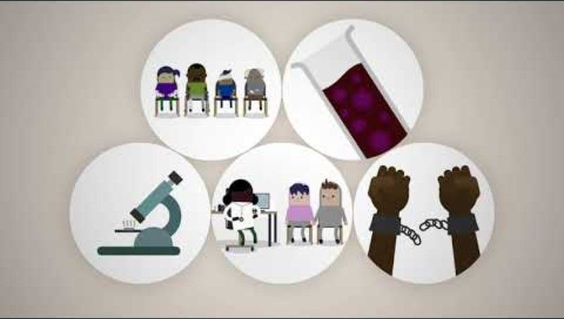
Assessing migrant patients
https://www.youtube.com/watch?v=LVcCNGrxau8

Slide 40

Access the toolkit

Slide 41
Supporting people seeking asylum
People seeking asylum often face complex and unmet health and social needs. Many have experienced trauma, violence, persecution, and prolonged periods with little or no access to healthcare. Once in the UK, they may continue to face significant challenges navigating an unfamiliar and complex healthcare system. These factors can lead to poor health outcomes.
Clinicians play a vital role in supporting people seeking asylum and refugees but face challenges due to system level NHS pressures
Barriers to accessing care – limited appointment times, limited availability of appropriate interpreting and specialised services
New resource aims to support clinicians in England, Scotland, and Wales in primary care to deliver informed, compassionate, and person-centred care to those navigating the asylum process.

Slide 42
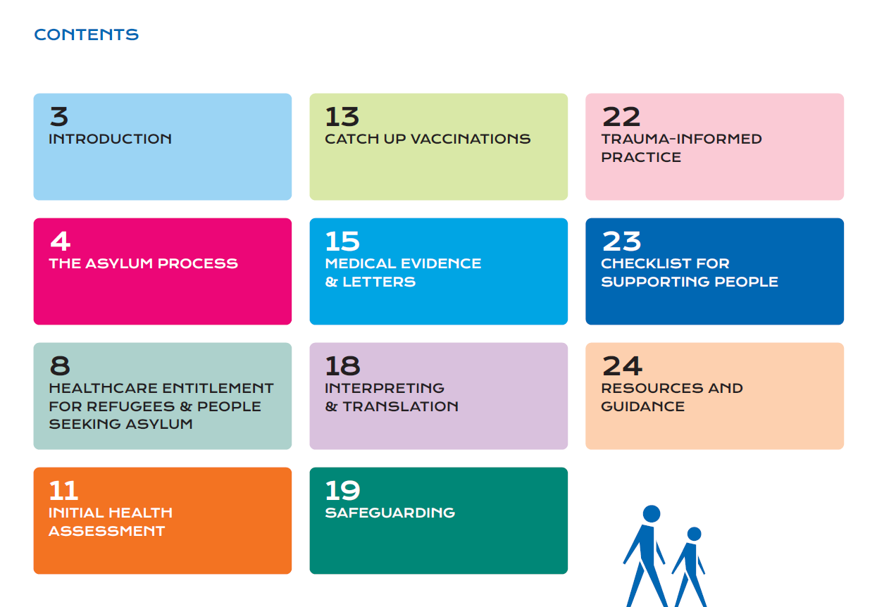

Slide 43
Checklist for supporting patients
Explain how the NHS works and entitlement to healthcare and provide patients with accessible translated information in their own language
Use professional interpreters in consultations and allow double time for appointments
Provide holistic screening and health assessment to understand both social and health needs. Use translated patient questionnaires to prioritise health needs
Provide letters as medical evidence for people seeking asylum free of charge when required, using templates
Proactively identify and schedule patients for catch-up immunisations in line with the UK immunisation schedule, including during new patient checks.
Offer handheld records for patients who may have frequent accommodation moves. Share GP transfer cards with patients
Refer to social prescribers to enable access to support such as immigration related support, community participation and voluntary services. Be aware of local organisations and support for patients.
If appropriate, inform about charges but encourage engagement with treatment and follow-up attendance at appointments, particularly antenatal care. Identify exemptions
Be aware of data-sharing fears and concerns around bills and Home Office

Slide 44
Next steps
What steps can you take to ensure all patients in your community can access healthcare?
Consider:
Individually
Practice wide

Slide 45
Find out more https://www.doctorsoftheworld.org.uk/safesurgeries/
Feedback
Please complete our training evaluation form
Translated health information https://www.doctorsoftheworld.org.uk/translated-health-information/
Contact us safesurgeries@doctorsoftheworld.org.uk
DOTW clinic https://www.doctorsoftheworld.org.uk/patient-clinic/
Volunteer with us https://www.doctorsoftheworld.org.uk/jobs-and-volunteer-roles/
Stay connected

Slide 46
Resources
Primary care
Secondary care
Safe Surgeries guidance & resources.
NHS England guidance on GP Registration
BMA guidance on GP registration
BMA refugee and asylum seeker patient health toolkit
CQC guidance on refugees, asylum seekers, and other migrants
Migrant Health Guide
Inclusion Health Self Assessment Tool for PCNs
DH Guidance on implementing charging
Upfront charging framework and clinical case studies
Navigating NHS Charging in Secondary Care – DOTW
Supporting families facing NHS charging – flowchart
Improving access to maternity care

